Slide 1

Professor Mark Ferguson, Director General
Science Foundation Ireland & Chief Scientific
Adviser to the Government of Ireland

Slide 2

Ireland’s Standing in Global Research & Innovation
Ireland 10th place in global rankings for the overall quality of scientific research - moving up 26 places in only 13 years
Field specific global excellence:
  2nd for Animal and Dairy
  2nd for Immunology
  2nd for Nanotechnology
  3rd for Materials Sciences
  4th for Agricultural Sciences
  5th for Chemistry
  6th for Basic Medical Research
  6th for Computer Science
Ireland ranked 10th in the world by the Global Innovation Index 2017

Slide 3
% of publications in the top 1% as measured by citations
Country | Funder | # Documents in Web of Science | Documents in the Top 1%
Ireland | All | 154,578 | 1.59%
Ireland | Science Foundation Ireland | 14,661 | 2.54%
USA | All | 8,489,771 | 1.76%
USA | NSF | 457,581 | 2.82%
USA | NIH | 698,000 | 2.88%
Denmark | All | 267,823 | 2.41%
Singapore | All | 201,478 | 2.08%
UK | All | 2,341,194 | 1.78%
Finland | All | 214,411 | 1.71%
New Zealand | All | 152,308 | 1.69%
Israel | All | 254,092 | 1.56%
China | All | 3,298,910 | 0.93%
EU | European Research Council | 49,575 | 4.71%
IRELAND: From 1980 - 2002, for any funder, the % of publications in the top 1% is 1.02%.
Therefore the overall system has improved – with a disproportionate impact from high quality SFI-funded publications
Source: Incites, Thomson Reuters 2003-2017

Slide 4
Patent citations as a measure of economic public good for oriented basic research
Test of “market failure” and “spill over” rationale for public investment in scientific research
Key Findings
300 companies are building IP on SFI funded research, 40% of these create jobs in Ireland, 10% of these are IDA client companies. Regional impact is evident.
50% of Ireland’s patent cited publications were funded in part or in whole by SFI.
31.1% of SFI Investigator Programme (IvP) awards between 2005 and 2013 produced a paper that was cited in a patent.

Slide 5
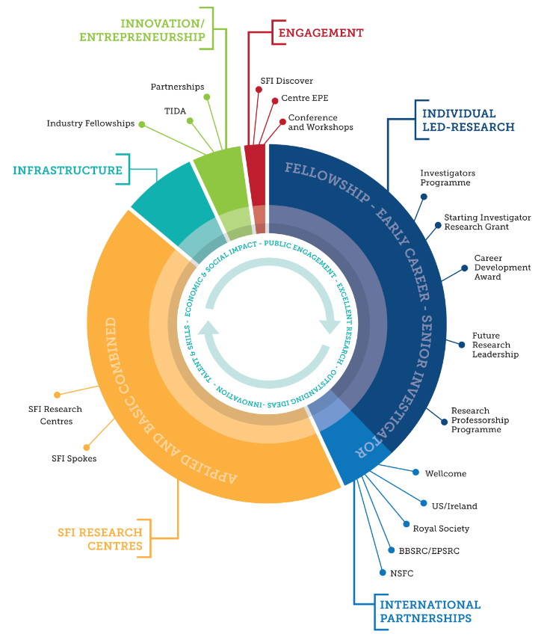
Science Foundation Ireland Portfolio

Slide 6
The performance (excellence and impact) of the researchers has increased, but SFI’s baseline budget is fairly static and the funded portfolio is balanced
SFI Core Baseline Budget:
2018 - €174.25m
2017 - €162.5m
2016 - €157m
2015 - €154m
Funded grant success rates similar e.g. for IvP:
IvP Call % success rate Reserve List no.
2016 17% 33
2015 17% 6
2014 17% 0
2013 17% 5
2017 Reserve Lists in IvP (33), CDA (8), Centres (3), TIDA (8), Discover (10)

Slide 7
Science Foundation Ireland Budget for 2018
Core baseline budget €174.25M
€162.5M as for 2017
+ €7.5M for new PhD Studentship Scheme
+ €4.25M for Future Milk SFI Research Centre
Existing Commitment to multi-annual funding of:
IvP, SIRG, CDA, Partnerships Programme, SFI Research Centres, Research Professorships, Future Research Leaders, International Partnerships (US Ireland, Wellcome, Royal Society, BBSRC, EPSRC, NSFC)
Approx. €150M

Slide 8
Science Foundation Ireland Highlights 2017
Individual Led Research
IvP: 26 awards
CDA: 22 awards
Future Research Leaders: 5 awards
US-Ireland: 4 awards
SFI-HRB-Wellcome Trust Partnership: 3 new Investigator awards
SFI - Royal Society Research Fellowship: 3 awards
NSF China: 46 projects are currently under review
  SFI Research Centres
  5 new Centres: Beacon, Confirm, FutureMilk, FutureNeuro, I-Form
  12 existing Centres: >€120M industry co-funding), >540 contracts signed, >€140M H2020 wins to date
  5 X 2015 Centres (Adapt, Connect, Curam, ICRAG, Lero): Successful 2-year international site reviews
  Spokes: 6 new awards
Strategic Partnerships
3 awards with cumulative industry cash co-investment of ∼€6M
ICORPS
8 teams completed programme
SFI Discover
€2.8 million for 44 public engagement and education initiatives

Slide 9
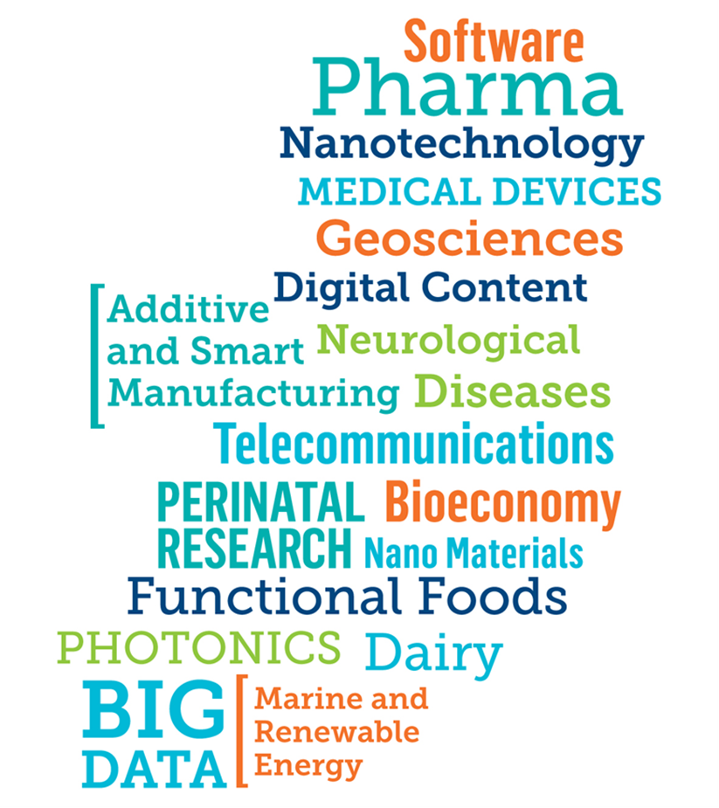
17 SFI Research Centres
ADAPT | Centre for Global Digital Content and Engagement
AMBER | Advanced Materials and BioEngineering Research Centre
APC | APC Microbiome Institute
BEACON | Circular Bioeconomy Research Centre
CONNECT | Future Broadband, Cellular and Internet of Things networks
CONFIRM | Smart Manufacturing and Industrial Automation Research Centre
CÚRAM | Centre for Research in Medical Devices
Future Milk | Precision (Smart) Agriculture Research for Dairy
Future Neuro | Neurological Diseases Research Centre
iCRAG | Irish Centre for Research in Applied Geosciences
I-Form | Advanced Manufacturing Research Centre
INFANT | Irish Centre for Fetal and Neonatal Translational Research
INSIGHT | Centre for Data Analytics
IPIC | Irish Photonic Integration Research Centre
LERO | Irish Software Research Centre
MaREI | Marine and Renewable Energy Ireland
SSPC | Synthesis & Solid State Pharmaceutical Centre

Slide 10




5 new SFI Research Centres in 2017-2018
∼€94m from SFI over 6 years
€55m from 130 industry partners
  Smart Manufacturing IT and industrial automation systems
  Biological Resources as alternative materials to finite fossil resources
  Innovative techniques and processes in advanced manufacturing
  Diagnosis, monitoring and treatment of chronic and rare neurological diseases
  Technologies to address the inter-dependent food-production chain from farm to gut
3 Centres (H-SYS, INNATE and Biologic) on the reserve list
Scientifically excellent and impactful by international peer review (approx. €55 million committed industry funding)
for which SFI currently has no budget to fund.
FutureMilk

Slide 11
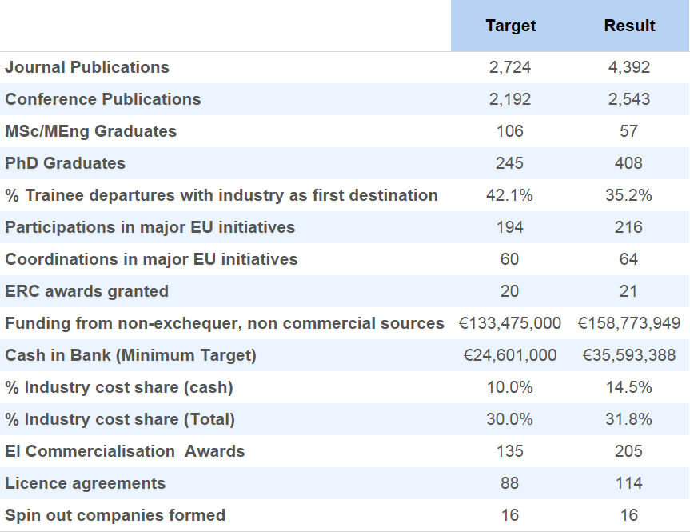
SFI Research Centres performing well
Cumulative performance of first 12 Centres up to June 2017
Academic
Human capital
Europe
Industry
co-fund
Entrepreneurial

Slide 12




SFI Investigators Programme – 2016-17 Call
Supporting excellent and impactful research leaders
26 awards made totalling >€39M cumulative value
Including ∼€4M co-funding from four partner agencies:
  Environmental Protection Agency – 2 projects
  Geological Survey of Ireland - 2 projects
  Marine Institute – 2 projects
  Teagasc – 2 projects
Reserve list of 33 projects deemed scientifically excellent and impactful by international peer review for which SFI currently has no budget to fund

Slide 13

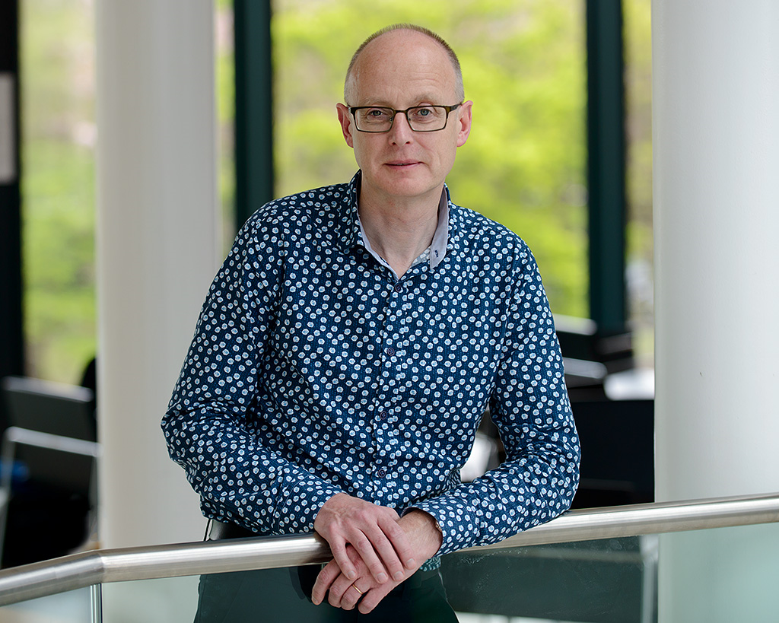
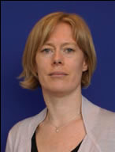


Excellence & Impact - Investigator Awardees holders
Highly Cited SFI Researchers 2017 - InCites
John Boland, TCD
Jonathan Coleman, TCD
Aiden Corvin, TCD
John Cryan, UCC
Kenneth Dawson, UCD
Michael Gill, TCD
Colin Hill, UCC
Derek Morris, TCD
Martin O’Donnell NUIG
Luke O’Neill, TCD
Paul Ross, UCC
Mike Zaworotko, UL
Prof Luke O’Neill and
team published paper
in the highly
prestigious
journal Cell
Prof Fiona Newell and Prof Carol O’Sullivan have been successful in securing funding from the EU commission for projects which involve significant interactions with gaming companies
Prof Ken Wolfe
was elected as a
Fellow of the
Royal Society
Prof James Gleeson’s work on social media
network analysis was mentioned in a Scientific
American article on How Fake News goes Viral

Slide 14
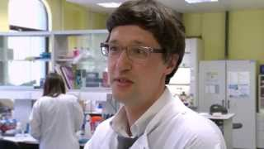
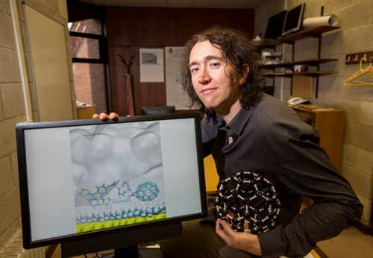
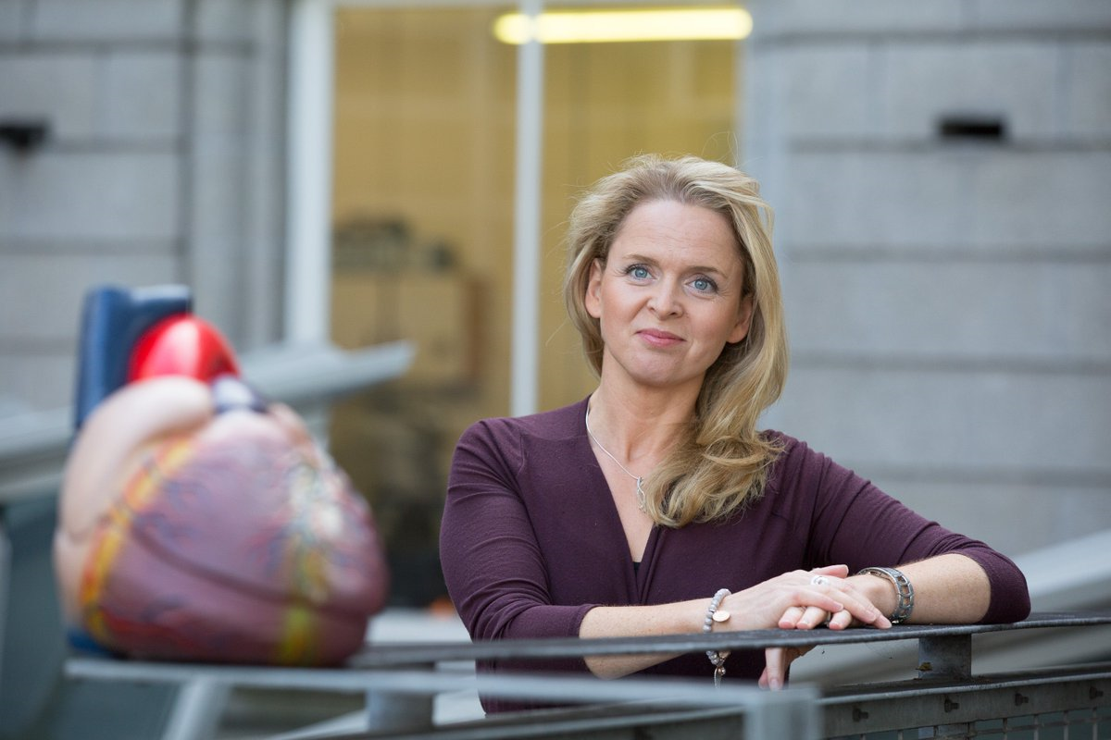
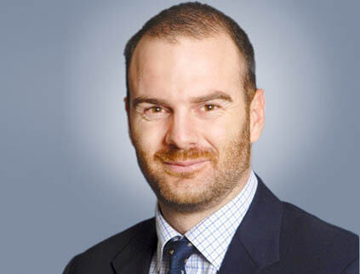
Supporting Early-Stage Researchers
SIRG/CDA/Royal Society URFs/Future Research Leaders
Caitriona Lally (CDA holder) is amongst 4 early career awardees from SFI who have all secured ERC Starting Grants | Gianpiero Cavalleri published a study that illustrates extensive genetic substructure within the Travellers and dates the divergence of the Travellers from Settled Irish to around 10 generations ago | PIYRA recipient Carel W. le Roux was part of a study used to change the international guidelines for the use of surgery in diabetic patients | SIRG awardee Damien Thompson has continued to publish in high-impact journals incl. Nature Materials, Nature Nanotechnology and Nature Communications
.

Slide 15
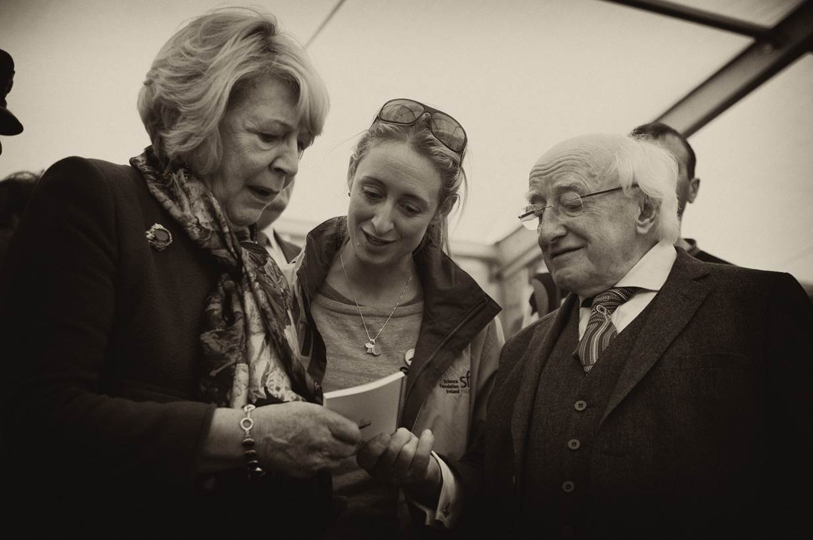
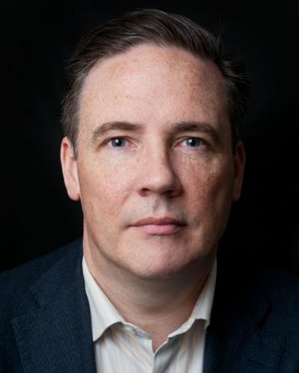


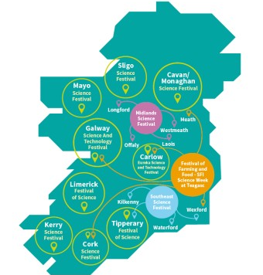

Education and Public Engagement Highlights
SFI Research Centre CÚRAM won AAAS Science Prize at NY Imagine Science Film Festival for Feats of Modest Valour | Shane O’Mara championed Science Week 2017 joining Profs Louise Kenny, Jennifer McElwain, Adrian Raftery and Dr Shane Bergin to engage 1,100 people at the Scintillating Science Show with Dara O’Briain | Science Week 2017 has highest number of events and regional reach, with researchers, industry and engagement professionals joining the campaign | SFI researchers attended National Ploughing Championships engaging with rural communities and policymakers including President Michael D Higgins and Tánaiste Frances Fitzgerald
.
.

Slide 16
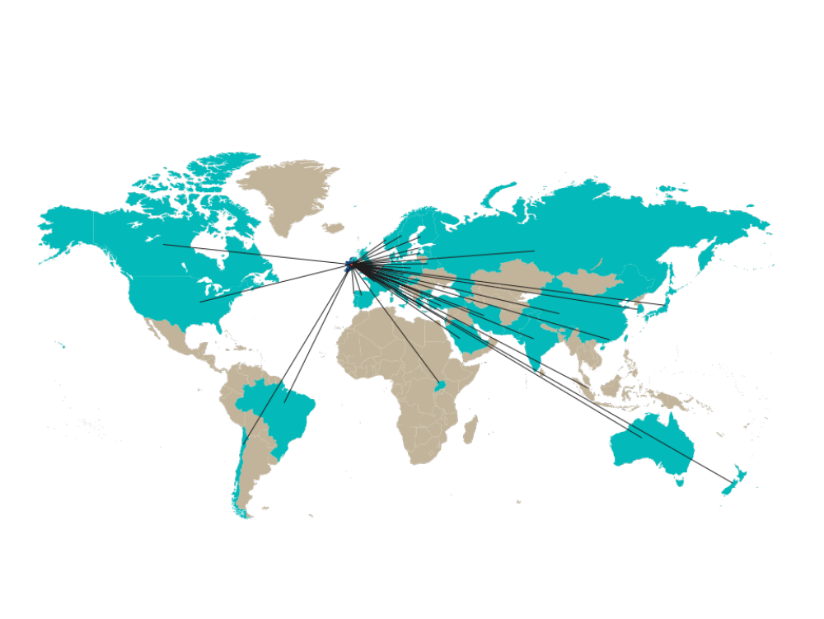







SFI International Partnerships in 2017
Strategic Partnerships – SFI-Fraunhofer Project Centre at DCU €5M partnership
UK
Germany
USA
US-Ireland 4 awards
NSF ICORPS @ SFI - 8 teams funded & completed programme
CHINA
SFI- NSF China partnership
46 projects are under review - decision early December
3 Royal Society-Science Foundation Ireland University Research Fellows in 2017
SFI-HRB- Wellcome Partnership – 3 Investigator Awards 2017
  EPSRC Standard Grants Programme
43 EOIs submitted
BBSRC partnership
EPSRC partnership

Slide 17
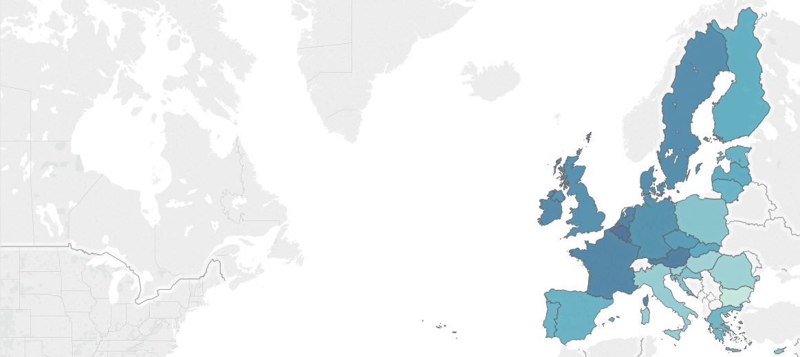
Horizon 2020 – Irish Success to date
Total draw down - €474,885,211
Successful proposals - 1,154
Success rates
Ireland
14.7% proposals
12.6% funding
Most successful areas
% Success rates (& drawdown)
Research Infrastructure 40.1% (€15m)
Smart transport 39.8% (€12m)
Agriculture & food 28.3% (€50m)
Draw-down (& % success rates)
MSCA €77.5 (13.6%)
ICT €75.5 (13.3%)
Health €65.2 (12%)
Denmark
14.5% proposals
12.5% funding
UK
14.6% proposals
13.7% funding

Slide 18
Horizon 2020 – Big Wins
Wins > €2m
28 IE participants
€43.4m
Information & Communications Technologies, Small & Medium Sized Enterprises, Low-Carbon Energy, Marie Skłodowska-Curie Actions-Cofund, Bio-based industries, Societal Challenges.
1 project: €13.2m –
AgriChemWhey
6 Irish partners:
2 Industry partners
2 Universities
1 Research Institute
1 County Council
Wins to-date > €1m
265 IE participants
€278.7m
57% of Irish draw-down
ERC
€60m
45 awards
13 in SFI Research Centres

Slide 19
2016-2017 Horizon 2020 Successes
ICT
MSCA Co-fund
APC Postdoctoral Excellence
€1.4 m APC
SLICENET, €1.5m
Redzinc, EMC, CIT Infinite
Project €8m
Advanced Learning in Evolving Critical Systems
€1.8m Lero
PixAPP €3.1m
IPIC & Eblana
€13.8m Project
RECAP €1.4m
DCU & Intel
Project €4m
Research Leaders 2025
€2.1m Teagasc

Slide 20
Horizon 2020 Work Programme 2018 – 2020
A low-carbon, climate resilient future: €3.3 billion
Circular Economy (connecting economic and environmental gains): €1 billion
Digitising and transforming European industry and services: €1.7 billion
Security Union: €1 billion
Clean Energy - €2.2 billion Targeting: renewables, energy efficient buildings, electro-mobility and storage solutions
Boosting 'blue sky' research
  ERC 2018 €1.86 billion. Marie Skłodowska-Curie Actions 2018-2020: €2.9 billion.
Enhancing international cooperation
  €1 billion towards 30 flagship initiatives (with for example Canada on personalised medicine, with the US, Japan, South Korea, Singapore and Australia on road transport automation, with India on water challenges and with African countries on food security and renewable energies)
Open Science: €2 billion including European Open Science Cloud and data infrastructure: €600m

Slide 21
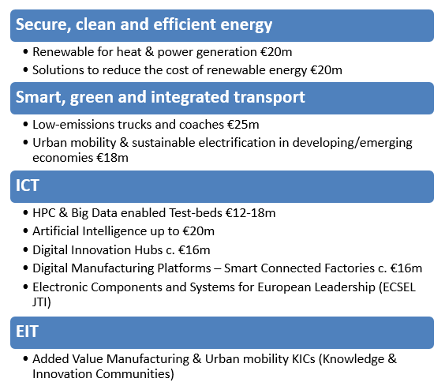
Horizon 2020 – large upcoming calls

Slide 22

2018 Priorities and New Initiatives
Focus on implementing Innovation 2020
50/50 balance across SFI’s portfolio –individual-led research/large scale centres
Brexit
Partnerships – international, industry, philanthropy, etc.
Supporting EU applications and successes

Slide 23
New PhD Programme
New PhD Programme
  Modelled on UK Centres for Doctoral Training, sustainable funding for research MSc and PhDs, 4 year structured programme, strong training emphasis, industry involvement, appropriate research expenses, strategic, in areas of high priority / employment need, widespread consultation Q1 2018, call for proposals Q2 2018, decision Q4 2018, recruit students for first intake 2019
Joint PhD Scheme with UK
  UK co-funded
  PhD cohorts registered in Ireland and UK, co-supervised, with mobility
  Pilot focused on SFI Research Centres and top UK Universities
2018 PhD intake
  For 2018 intake focused on reserve list projects and widening participation in SFI Research Centres, e.g. non Centre PI’s in Universities and IoT’s, UK co-supervisors

Slide 24
2018 Plans
Enhanced support for ERC applications
ERC focused Research Professorship
Research Infrastructure call
  (fundable projects will be live for 2 years)
2018 Call Timetable will be published as usual at the end of 2017, following approval at the December 2017 SFI Board

Slide 25


Thank You

