Slide 1




Comparing the Opinions of the Science Community and the General Public in Ireland
An Amárach Briefing to Science Foundation Ireland
November 2017

Slide 2
Presentation Structure
Background & Methodology
SECTION 1: The Impact of Science
SECTION 2: Climate Change & Natural Resources
SECTION 3: Medicine & Food
SECTION 4: Evolution & The Big Bang
SECTION 5: The Role of Science
SECTION 6: Scientists & Scientific Achievements Awareness
SECTION 7: Comparing Ireland Internationally

Slide 3
Background & Methodology
In advance of Science Week 2017, Science Foundation Ireland sought to conduct research to measure and compare the opinions of the general public and the science community in Ireland. Questions were asked across a range of subject including the impact of science on everyday life, climate change and evolution, amongst others.
The research format was based on the Pew Research Centre, a non-partisan think tank that informs the public about the issues, attitudes and trends shaping the world.
The objective of the research was to uncover any differences and/ or similarities in the views and perceptions of the general public and Irish scientists on issues relating to science and everyday life.
A national online survey of 1,000 adults* was conducted between 13th – 17th October, while 238 members of the science community were surveyed online, via an email link sent to researchers working in academia and industry by Science Foundation Ireland.
*referred to as general public throughout

Slide 4
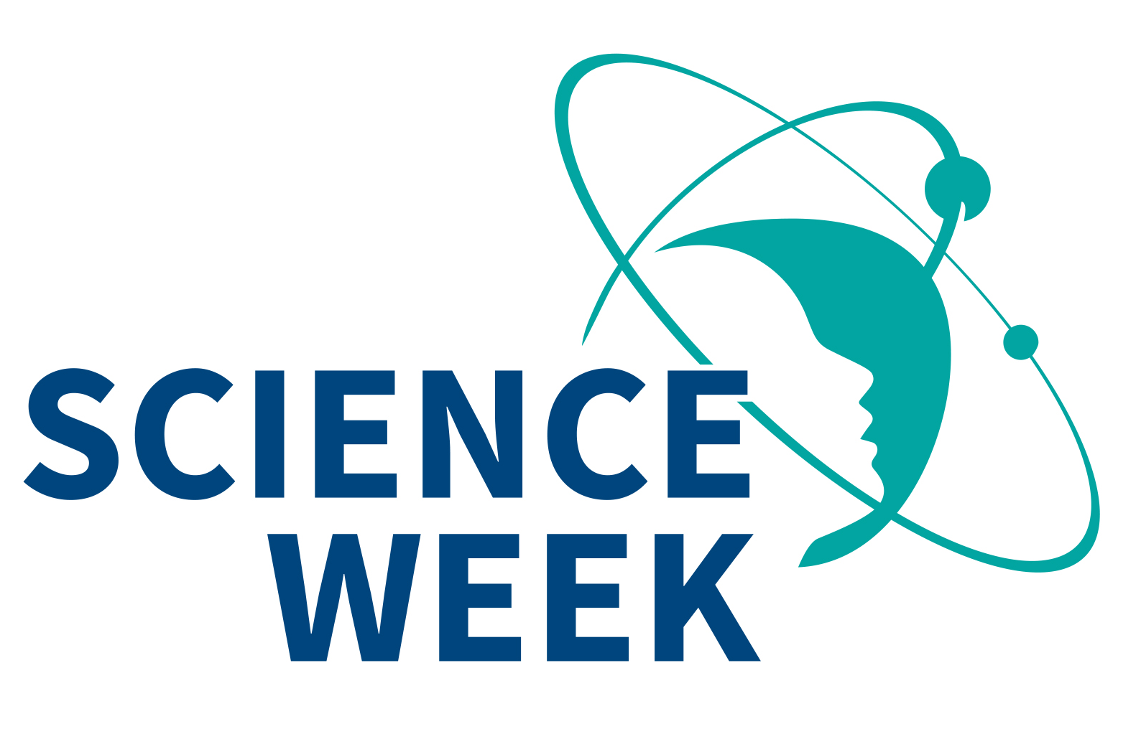
The Impact of Science

Slide 5

Q.1 Science has had a positive impact on people’s lives in Ireland.
Public – 1,001 Scientists - 239

Slide 6
Public Vs. Science Community % who believe science has had a positive impact on…
Public – 1,001 Scientists - 239

Slide 7
Climate Change & Natural Resources

Slide 8
Q.3 Climate change is mostly due to human activity...
Public – 1,001 Scientists - 239

Slide 9
Q.3 The earth is getting warmer as a result of climate change…
Public – 1,001 Scientists - 239

Slide 10
Q.3 There is broad agreement within the science community about the causes of climate change…
Public – 1,001 Scientists - 239

Slide 11
Q.3 The growing world population will put a strain on natural resources…
Public – 1,001 Scientists - 239

Slide 12
Q.3 The planet’s resources will sufficiently be able to deal with a growing population…
Public – 1,001 Scientists - 239

Slide 13
Q.3 Wind turbine farms are an acceptable form of energy…
Public – 1,001 Scientists - 239

Slide 14
Medicine & Food

Slide 15
Q.4 It is safe to eat genetically modified foods…
Public – 1,001 Scientists - 239

Slide 16
Q.4 It is safe to eat foods with pesticides…
Public – 1,001 Scientists - 239

Slide 17
Q.4 Vaccinations are an acceptable form of preventative medical treatment…
Public – 1,001 Scientists - 239

Slide 18
Q.4 I would support the bioengineering of artificial organs for use in transplants…
Public – 1,001 Scientists - 239

Slide 19
Evolution & The Big Bang

Slide 20
Q.5 The universe was created by a big explosion almost 14 billion years ago…
Public – 1,001 Scientists - 239

Slide 21
Q.5 How the universe was created can be sufficiently explained by science…
Public – 1,001 Scientists - 239

Slide 22
Q.5 There is agreement amongst scientists that the universe was created by a big explosion…
Public – 1,001 Scientists - 239

Slide 23
Q.5 Humans evolved over time guided by a supreme being…
Public – 1,001 Scientists - 239

Slide 24
Q.5 Life on earth, including humans, evolved through a process of natural selection…
Public – 1,001 Scientists - 239

Slide 25
Q.5 Humans have existed in present form since the beginning…
Public – 1,001 Scientists - 239

Slide 26
The Role of Science

Slide 27
Q.6 It is important for scientific findings to inform government policy...
Public – 1,001 Scientists - 239

Slide 28
Q.6 Scientific findings regularly inform government policy…
Public – 1,001 Scientists - 239

Slide 29
Q.7 The general public does not know much about science...
Public – 1,001 Scientists - 239

Slide 30
Q.7 The general public finds it hard to distinguish which scientific findings are well-founded…
Public – 1,001 Scientists - 239

Slide 31
Q.7 There is not enough science education in schools…
Public – 1,001 Scientists - 239

Slide 32
Q.7 The general public expects science to find solutions to problems too quickly…
Public – 1,001 Scientists - 239

Slide 33
Q.8 I am interested in science news…
Public – 1,001 Scientists - 239

Slide 34
Q.8 There is a lack of public interest in science news…
Public – 1,001 Scientists - 239

Slide 35
Q.8 The Irish media lacks coverage of science news…
Public – 1,001 Scientists - 239

Slide 36
Q.8 Scientists in Ireland are communicating science news sufficiently…
Public – 1,001 Scientists - 239

Slide 37
Q.8 The news media over-simplifies science news…
Public – 1,001 Scientists - 239

Slide 38
Awareness of Scientists & Scientific Achievements

Slide 39
Q.9 Please name any Irish scientists, past or present, that you are aware of?
All other mentions 1% or less
All other mentions 5% or less
69% of the public do not know of any Irish scientists, past of present.

Slide 40
Q.10 Please name any Irish scientific achievements, past or present, that you are aware of?
All other mentions less than 1%
All other mentions 6% or less
72% of the public do not know of any Irish scientific achievements, past of present.

Slide 41
Q.11 In your opinion, what do you believe to be the single greatest scientific achievement ever made?
All other mentions 2% or less
All other mentions 5% or less
35% of the public could not name what they believed to be the single greatest scientific achievement ever made

Slide 42
Comparing Ireland Internationally

Slide 43
Ireland performs well internationally in…
Public – 1,001 Scientists - 239

Slide 44
Q.12 Ireland performs well internationally versus other industrialised nations in the following areas: Scientific achievements
Public – 1,001 Scientists - 239

Slide 45
Q.12 Ireland performs well internationally versus other industrialised nations in the following areas: Medical treatment
Public – 1,001 Scientists - 239

Slide 46
Q.12 Ireland performs well internationally versus other industrialised nations in the following areas: Economic development
Public – 1,001 Scientists - 239

Slide 47
Q.12 Ireland performs well internationally versus other industrialised nations in the following areas: STEM education
Public – 1,001 Scientists - 239

Slide 48
Q.12 Ireland performs well internationally versus other industrialised nations in the following areas: Sporting achievements
Public – 1,001 Scientists - 239

Slide 49
Q.12 Ireland performs well internationally versus other industrialised nations in the following areas: Artistic achievements
Public – 1,001 Scientists - 239

Slide 50
Appendix – Detailed Analysis of Question 2

Slide 51
Q.2 Science has had a positive impact on the following areas of everyday life: Healthcare
Public – 1,001 Scientists - 239

Slide 52
Q.2 Science has had a positive impact on the following areas of everyday life: Food
Public – 1,001 Scientists - 239

Slide 53
Q.2 Science has had a positive impact on the following areas of everyday life: The Environment
Public – 1,001 Scientists - 239

Slide 54
Q.2 Science has had a positive impact on the following areas of everyday life: Transport
Public – 1,001 Scientists - 239

Slide 55
Q.2 Science has had a positive impact on the following areas of everyday life: Quality of Life
Public – 1,001 Scientists - 239

Slide 56
Q.2 Science has had a positive impact on the following areas of everyday life: Family Life
Public – 1,001 Scientists - 239

Slide 57
Q.2 Science has had a positive impact on the following areas of everyday life: Education
Public – 1,001 Scientists - 239

Slide 58


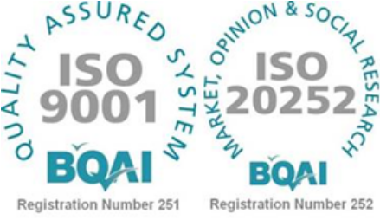
e. info@amarach.com
t. 01 410 5200
w. www.amarach.com
b. www.amarach.com/blog
Tw. twitter.com/AmarachResearch
s. slideshare.net/amarach/

