Slide 1

The Nuts and Bolts of NIH Funding
NIH TOP 10
Megan Columbus
Division of Communication and Outreach
NIH Office of Extramural Research

Slide 2
Top 10 Questions
#1: Where’s the money?
#2: How do I get some?
#3: Should I talk to someone at NIH before applying?
#4: How long does it take to get funded?
#5: What’s the right type of grant for my idea (and me)?
#6: Got Funded! Now What?
#7: Not Funded! Now What?
#8: How do I track my application?
#9: Where is my “go-to” place for info?
#10: Final Pieces of Advice?

Slide 3

#1 Where is the Money?

Slide 4



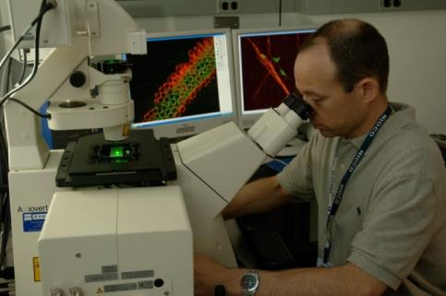
NIH: Steward of Biomedical & Behavioral Research for the Nation
“Science in pursuit of fundamental knowledge about the nature and behavior of living systems . . .
and the application of that knowledge to extend healthy life and reduce the burdens of illness and disability
Notes:
4
[Animated, 1 click]
There are two broad categories contained in the NIH Mission Statement.
The first relates to biomedical research
[Click] And the second, to the health of the nation – and, indeed, of all humanity, here at home and throughout the world
These, then, are the main categories of our analysis.
Note: The first picture (right) was provided by NIDCD. Dr. Mathew Kelley, Developmental Neuroscience Sect, NIDCD.

Slide 5

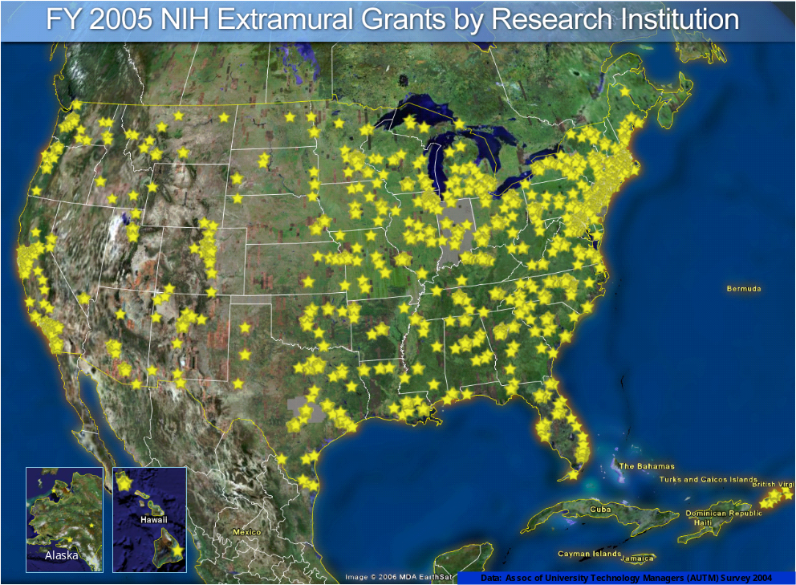

Understanding the Dual Nature of NIH
NIH is an institution
(Intramural Research)
~Approx. 6,000 scientists
~Approx. 10% of NIH
budget
NIH supports institutions & people
(Extramural Research)
>4,000 institutions
>300,000 scientists & research personnel
~Approx. 80% of the NIH budget

Slide 6
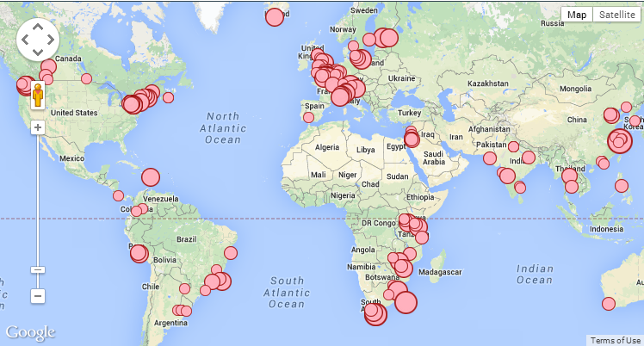
FY13 Funding
449 funded projects to foreign organizations, totaling $222.7m

Slide 7


























27 Institutes and Centers (IC)
Each with a different:
  mission & priorities
  budget
  funding strategy
NIGMS
International Center
Clinical Center

Slide 8

NIH Funding Opportunities
Advertised through
  www.Grants.gov
  NIH Guide for Grants and Contracts
Issued by
  Each NIH Institute and Center (IC)
  Multiple ICs may be listed on an FOA

Slide 9
Types of
Funding Opportunity Announcements (FOA)
Type of FOA | Description
Program Announcements (PA, PAR, PAS) | Highlights areas of focus Usually ongoing (3 yrs) Often use standard receipt dates
Requests for Applications (RFA) | Narrowly defined scope Usually single receipt date Set aside funds IC usually convenes review panel
Parent Announcements | Type of program announcement Generally span the breadth of NIH mission By activity code (R01, R03, etc) For “investigator initiated” or “unsolicited” research ideas

Slide 10

#2: How Do I Get Some?

Slide 11
Where to start
Identify a funding opportunity
  If no FOA specific to your area, look for a “parent” announcement
Talk with NIH staff about your idea and where it fits
Write a strong proposal that addresses review criteria
  Significance
  Investigators
  Innovation
  Approach
  Environment

Slide 12
Prepare to Apply
Learn about the application submission process well before the application due date
Complete/renew required registrations
  Institutions are required to register in multiple systems
  Investigators must register in the eRA Commons
  Registrations can take many weeks to complete (So start now!)
Prepare to Apply and Register
Find & Initiate Application
Prepare and Application
Submit Track and View Application
Learn more at http://grants.nih.gov/grants/ElectronicReceipt

Slide 13

Developing the application
Carefully read the funding opportunity.
Carefully read the funding opportunity.
Carefully read the funding opportunity.
Carefully read the application guide.
Carefully read the application guide.
Carefully read the application guide.
If instructions conflict, follow the funding opportunity.

Slide 14
Know Your Institution
What is your role?
What roles do other people play?
  Authorized Organizational Representative
  Principal Investigator
  Administrator
Coordination and respect for each other’s roles is key
Understand your institutional processes and timelines for grant related activities

Slide 15
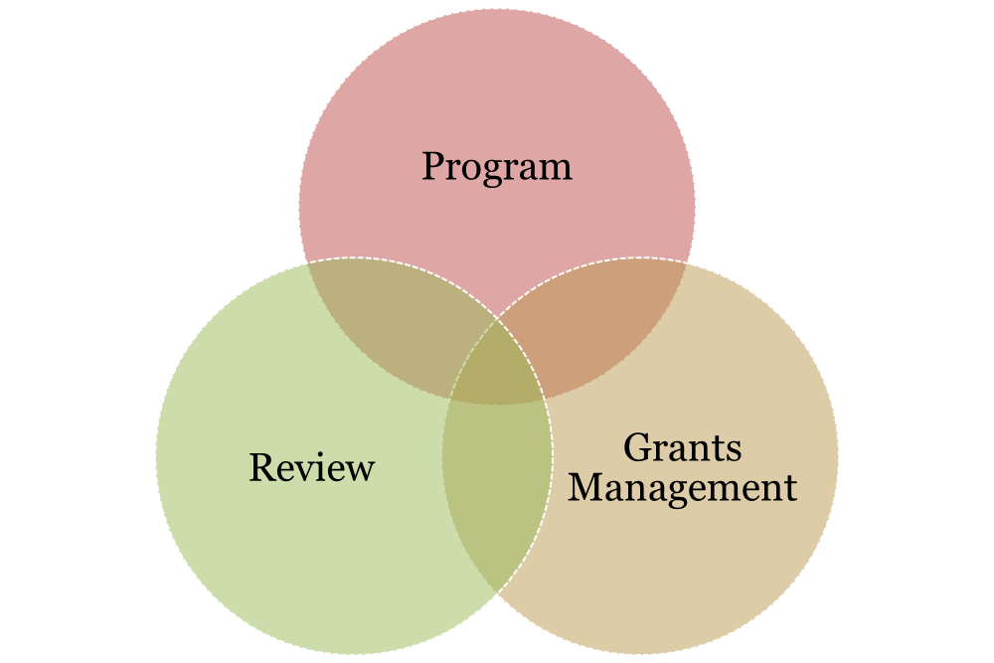
Understand the NIH Extramural Team at the Institutes and Centers
Notes:
15
Review, programt and grants management each have a role in the application/award process, so we’ll go into those a little bit now.

Slide 16
Program Official
Responsible for the programmatic, scientific, and/or technical aspects of a grant
Provides scientific guidance to investigators pre- and post-award
Develops initiatives
Provides post-award oversight
Notes:
16

Slide 17
Scientific Review Officer
Responsible for scientific and technical review
  Ensures fair and unbiased evaluation of scientific and technical merit
  Provides a summary of the evaluation
  Reviews applications for completeness and conformance with application requirements
Point of contact for applicants during the review process
Notes:
17

Slide 18
Grants Management Officer
Responsible for completion of business management requirements
  Evaluates applications for administrative content and compliance with policy
  Negotiates Awards
  Interprets grants administration policies
Notes:
18
Just as an official request must come from the aor, the official response must come from grants management.

Slide 19

#3: Should I talk to someone at NIH before applying?

Slide 20
Do I Contact NIH Before Applying?
Yes!
Mandatory
Application with budget >$500,000 direct costs for any single year
R13 Conference Grants
Optional
When RFA’s request a Letter of Intent
Always Recommended
When you think about applying for any grant
Notes:
20

Slide 21

#4: How Long Does It Take to Get Funded?

Slide 22


How does an application get funded?
National Institutes of Health
Center for Scientific Review
Assigns to IC & Review Group
Great Research Idea!
Institution
Study Section
Submits Application
Reviews for Scientific Merit
Institute
Allocates Funds
Evaluates for Relevance
Investigator
Advisory Council
Performs the Research
Recommends Action
Institute Director
Makes Funding Decision
Application to award takes ~9-10 months.

Slide 23

#5: What’s the Right Type of Grant for My Idea (and Me)?
Research Projects
Small Business
Training & Career Development
Research Centers

Slide 24
Foreign Eligibility
Foreign institutions are eligible to apply for most research grants
They are NOT eligible to apply for:
  NRSA institutional research training grants
  Program project grants
  Center grants
  Small business grants
  Construction grants
However, they may be eligible to be a foreign component on a domestic application
Check the FOA for eligibility requirements!

Slide 25

#6: Got Funded…Now What?

Slide 26

You’ll Receive a Notice of Award (NoA)
Legally binding document
  Award data and fiscal information
  Grant payment info
  Terms and conditions of award
Grantee accepts terms and conditions of award when draws down funds
Notes:
26

Slide 27

NIH Grants Policy Statement
Is a term and condition of all grant awards
Explicitly defines roles, responsibilities
  grants.nih.gov/grants/policy/nihgps_2013
Notes:
The standard terms and conditions are located in the NIHGPS. The NIHGPS incorporates the applicable grant regulations that apply to NIH awards.
An award that includes a conditional restriction should include the appropriate details as to how to lift that restriction, eg who to submit info to
The award-specific terms are located on the awards document, including a mention of the appropriate use of unobligated funds, and whether or not those funds are available for automatic carryover.
There are informational terms, including appropriate URLs and addresses for submitting information.
And the most helpful information bits are the names and contact information of your grants management specialist and program official. The contact information will include the telephone number and e-mail address

Slide 28

Post Award Management
Annual progress reporting
Annual federal financial reporting
Invention reporting
Yearly audits (as applicable)
Closeout reporting

Slide 29

#7: Not Funded! Now What?
RESUBMISSION AVENUE
NEW PROPOSAL LANE

Slide 30
Regroup
Take a deep breath
Read summary statement
Read it again
Talk with your NIH program official
Evaluate your options
  Revise & submit again?
  Choose a new research direction?

Slide 31

#8: How do I track my application?

Slide 32

Commons.era.nih.gov
In Commons you can find:
Application image
Application status
Assignments (institute, review group)
NIH staff contacts (SRO, program, grants management)
Scores
Summary statement (PI only)
Notice of Award
Links to tools for reporting, no cost extensions, etc.
and more…

Slide 33
Commons.era.nih.gov
Work with your institution’s office of sponsored research to be sure you are registered and your account is affiliated with your institution BEFORE you apply.
2 weeks lead time – PI registration in Commons
6-8 weeks – All institutional registrations and renewals

Slide 34

#9: Where is my “go-to” place for information?
eRA
Web-
sites
NIH Guide
NoA
Application
RePORT
Grants Policy
Statement

Slide 35

Bookmark NIH.gov
NIH.gov

Slide 36

Bookmark Grant.nih.gov
Bookmark GRANTS.nih.gov

Slide 37

Trying to make heads or tails of the grants process?

Slide 38

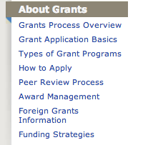
Check out grants process overview
Notes:
38

Slide 39
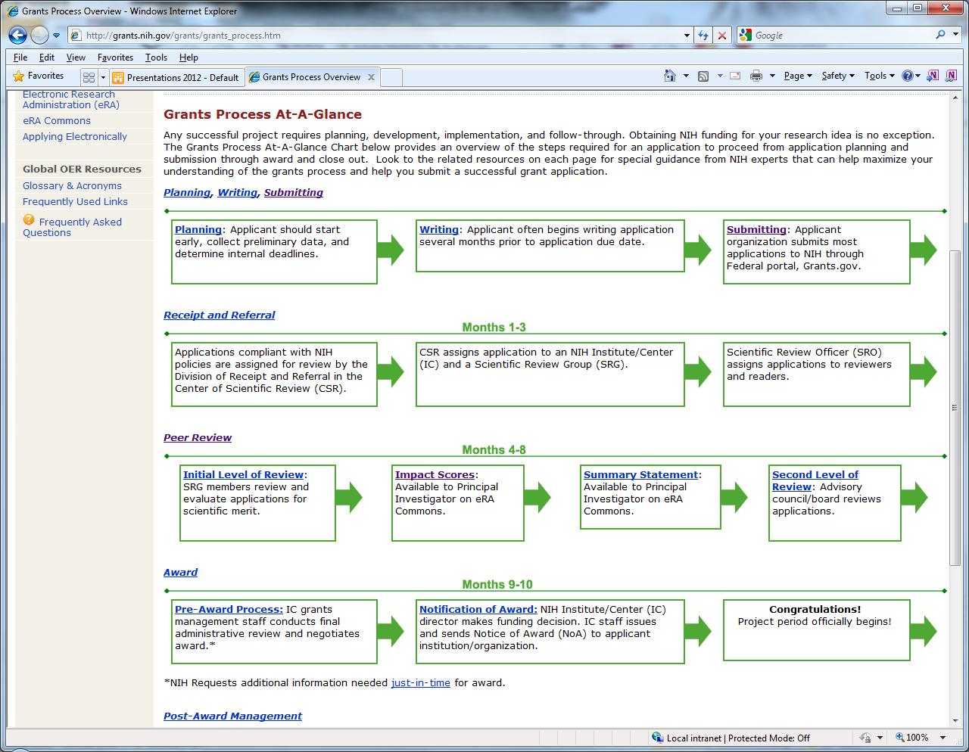
Grants process overview chart
grants.nih.gov/grants/grants_process.htm
Notes:
39

Slide 40
Types of grant Programs link
Find Grants Info at: http://www.grants.nih.gov/
Notes:
40

Slide 41
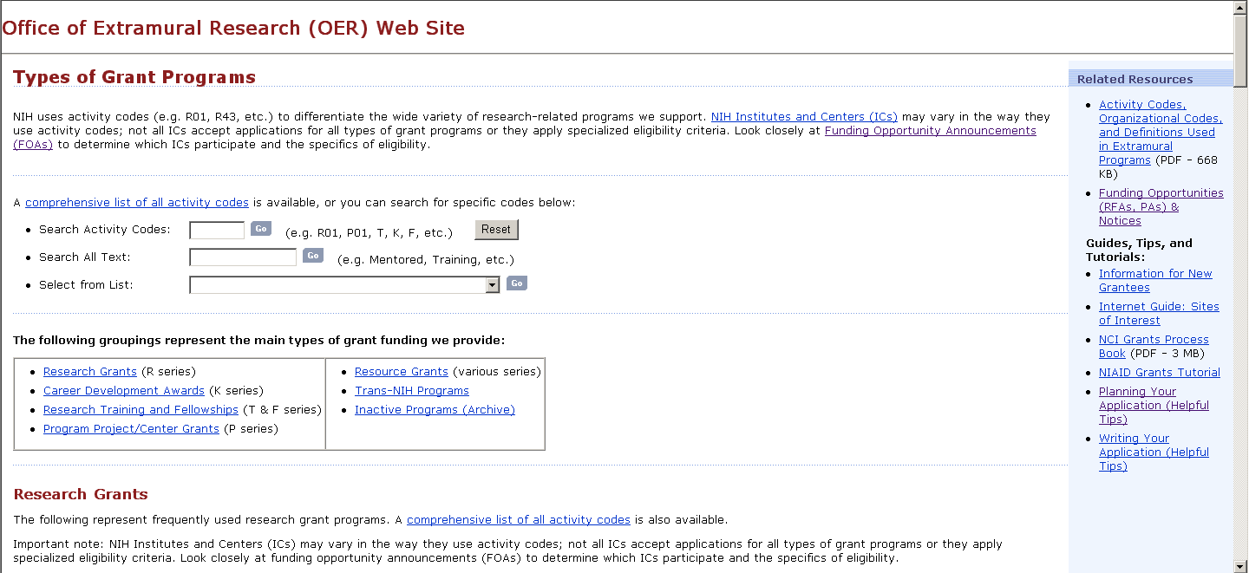
Types of grant programs page
What is an R03, F31, X02, etc?
Find out here!
grants.nih.gov/grants/funding/funding_program.htm

Slide 42
Looking for the latest grants policy changes or funding announcements?

Slide 43

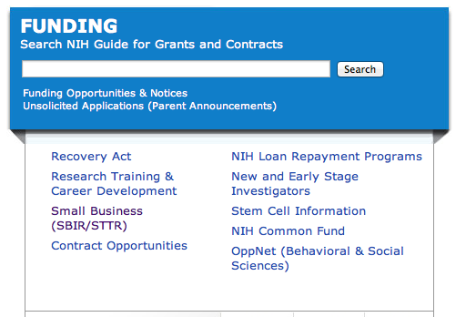
NIH Guide Grants.nih.gov

Slide 44
What can I find in the NIH Guide to Grants and Contracts?
  NIH specific funding opportunity announcements
  NIH policy notices
  Other announcements
    Changes to FOAs
    Events like this regional seminar
    NIH response to natural disasters or electronic system problems
    Etc.

Slide 45
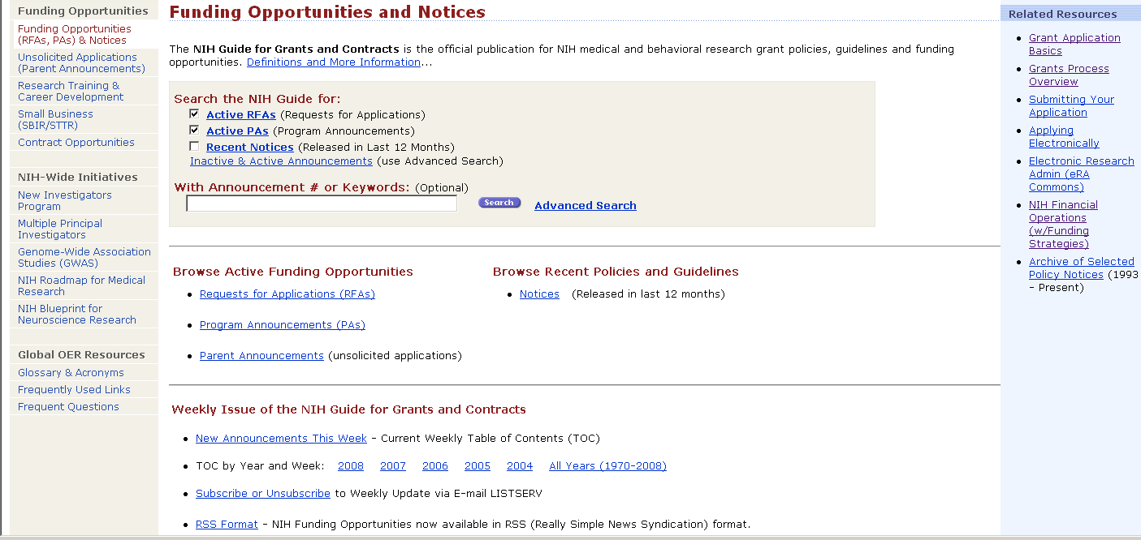
NIH Guide is published daily.
Subscribe to listserv to receive table of contents each Friday…
or subscribe to our RSS feed or follow us on Twitter

Slide 46

When are applications due?

Slide 47


Slide 48
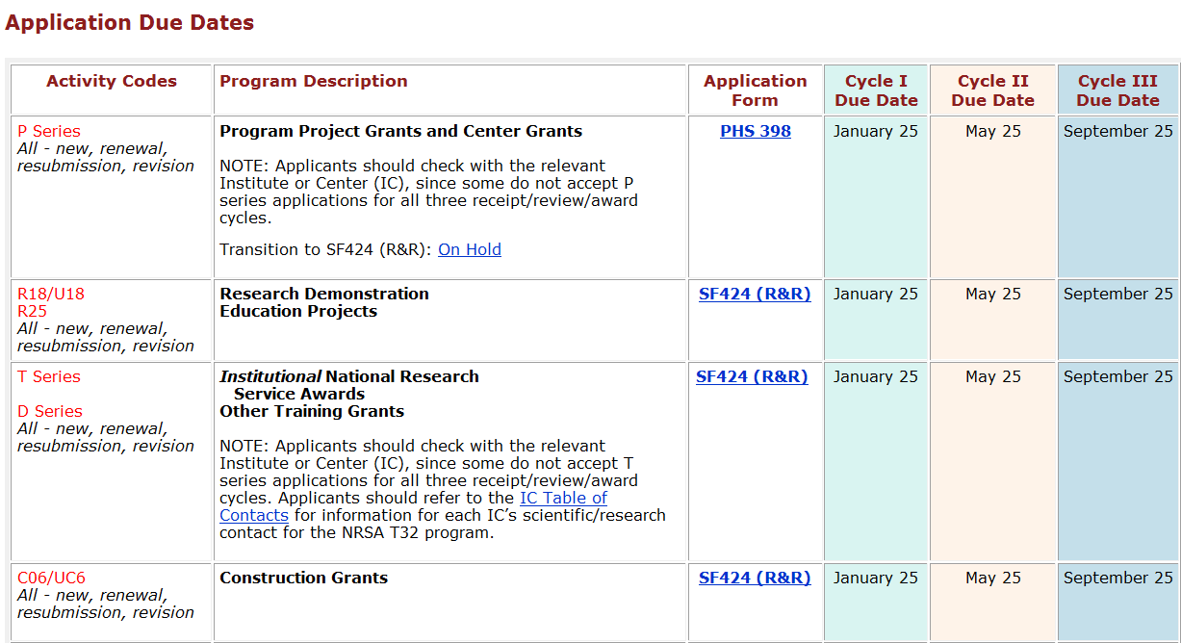
3 standard receipt dates a year.
Standard receipt dates for each type of grant
Scroll further on page for timelines for each “round”

Slide 49
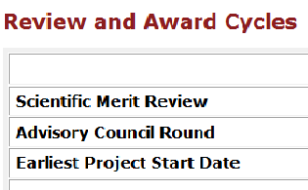
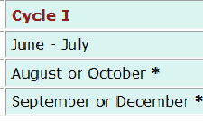
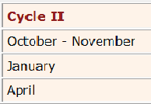
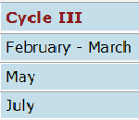
grants.nih.gov/grants/funding/submissionschedule
Review dates and earliest start date by submission round

Slide 50
Submission Policy Page
Answers common questions on:
On time submission
Standard due dates falling on a weekend or holiday
Late applications
Post submission application materials
Time limits for resubmitting application
Resubmission timelines for new investigator R01 applications
Etc…
grants.nih.gov/grants/funding/submissionpolicies.htm

Slide 51

Doing the right thing

Slide 52

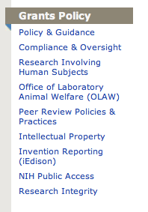
Grants Policy Resources
http://www.grants.nih.gov/

Slide 53

Make sense of our ever changing environment

Slide 54


Get Connected @ Grants.nih.gov
Get Connected @ grants.nih.gov

Slide 55
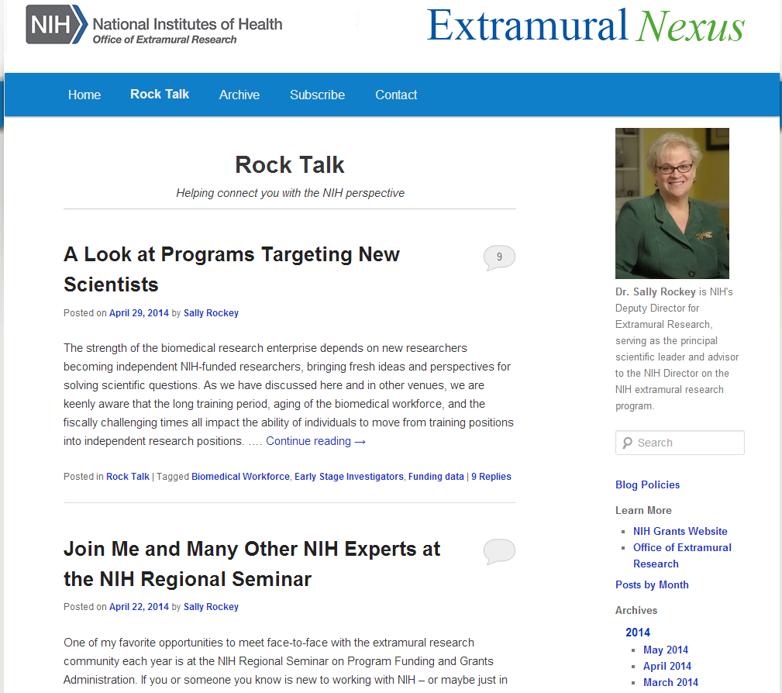
Extramural Nexus and Rock Talk Blog
Subscribe to the monthly Nexus for a summary of NIH grant happenings, resources, events.
Join the discussion on the Rock Talk blog!
http://nexus.od.nih.gov
http://nexus.od.nih.gov

Slide 56







Connect with us on social media! grants.nih.gov/grants/social_media.htm
Rock Talk
All About Grants
NIH Grants
@NIHgrants
@NIHfunding
@RockTalking …
Loan Repayment Program
AREA
NIH Office of Extramural Research
NIHgrants

Slide 57


All About Grants Podcast
All About Grants Channel on iTunes or download directly from webpage
grants.nih.gov/podcasts/All_About_Grants

Slide 58
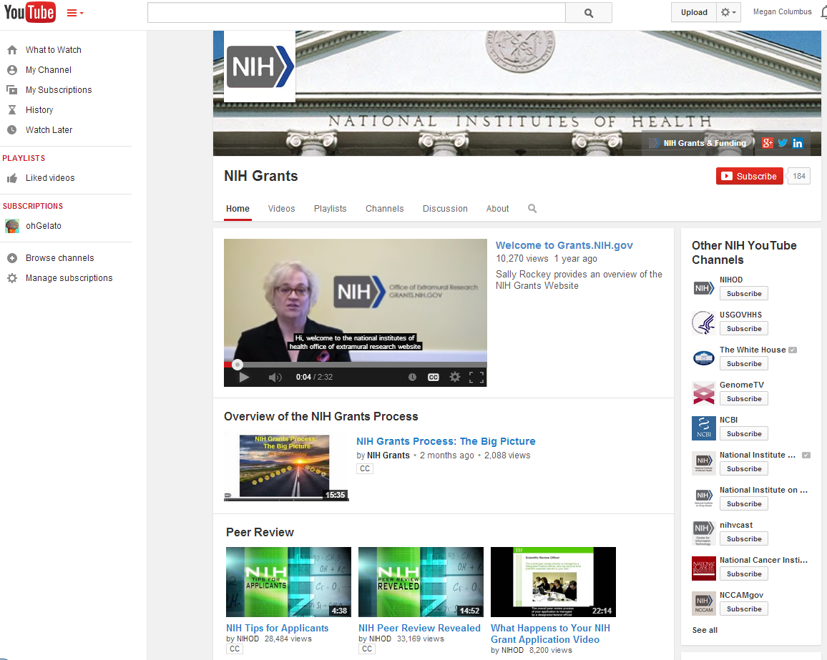
NIH Grants YouTube Channel
NIHGrants Channel on YouTube

Slide 59
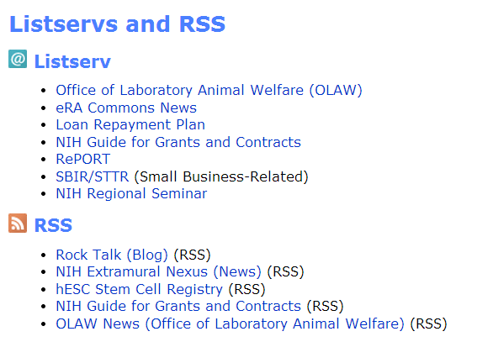
Listservs and RSS feeds provide valuable info

Slide 60

#9: Who do I talk to?

Slide 61
Finding the Right Staff Contacts
FOAs include contact names for program, review and grants management staff.
Institute websites have org charts or contact lists so to help you find a name. www.nih.gov
RePORTER provides the NIH program official’s name for funded projects. projectreporter.nih.gov
Use the NIH Staff Directory if you already have a name ned.nih.gov

Slide 62

NIH Home page
www.nih.gov

Slide 63
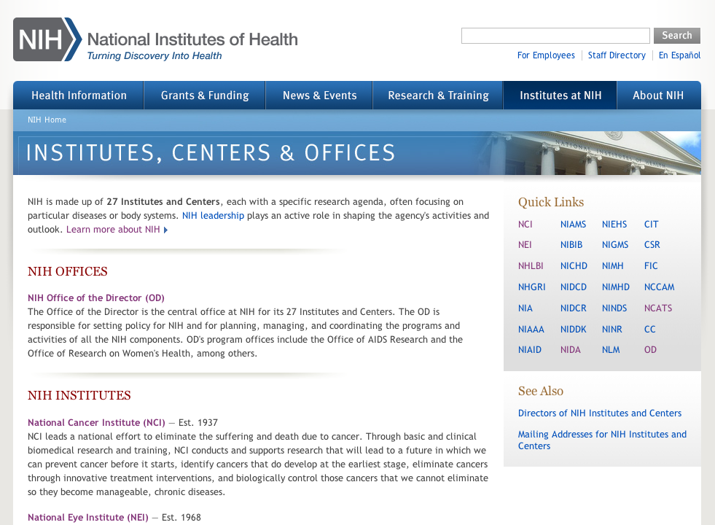
Central institute, center and office info
Bookmark your favorite Institute!
www.nih.gov/icd

Slide 64

#10: Final Pieces of Advice?
You will be successful

Slide 65
Do your research
Make connections
Read the fine print

Slide 66
Thank You
Megan Columbus
301-435-2496
Megan.columbus@nih.gov

