Slide 1



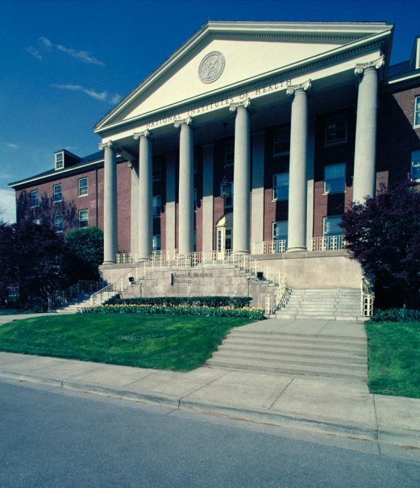
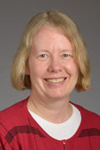


Grant Writing for Success
GRANT WRITING FOR SUCCESS
Teresa L. Z. Jones M.D., NIDDK/NIH

Slide 2
Hallmarks of an Outstanding Grant Application
Strong significance to an important problem in public health
Clear rationale
High degree of novelty and innovation
Strong track record by a well qualified applicant
Relevant and supportive preliminary data
Clear and focused approach that provides unambiguous results
Careful attention to details in the presentation

Slide 3
Common Reasons Cited for a Weak Application
Significance and impact not obvious or weak
Too ambitious, lacking focus
Unclear or flawed hypothesis or rationale
Applicant track record weak or lacking appropriate expertise
Feasibility unsupported
Approach flawed
Poor writing

Slide 4
Grantsmanship Tips
101
GET FEEDBACK
Show your draft specific aims page to a colleague
Show your draft Specific aims to a colleague… who does not already know what you intend to do
Show your draft specific aims to a NIH Program official

Slide 5
National Institutes of Health
Mission of each NIH Institute or Center (IC) is based and defined in law
  Authorizations (create/continue an agency – periodic)
  Appropriations ($ for the agency – annual)
ICs establish specific research emphases
  Legislative mission
  Current state of science
Use the Web to find out!

Slide 6

www.nih.gov

Slide 7
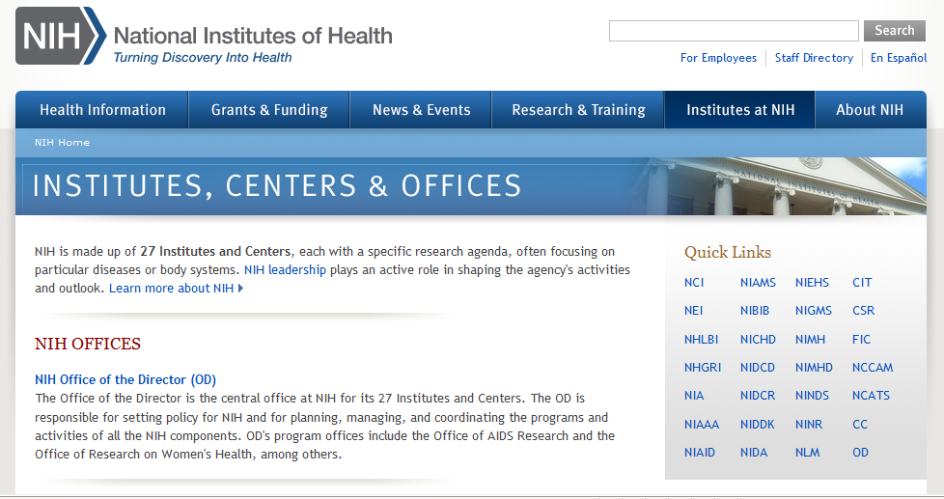
Look for the IC Website of Interest

Slide 8
Grantsmanship Tips
101
Study sample applications
  From a website, http://www.niaid.nih.gov/researchfunding/grant/pages/appsamples.aspx#rpindex
  From a colleague
Notes:
8
8

Slide 9
US - Ireland R&D Partnership
Write for the study section.
The science, rather than the program, should be the driver for the partnership.
Synergy, organization and feasibility of the collaboration should be clear. (Multi-PI Leadership Plan)
Strong recommendation for a US investigator with history of NIH funding.

Slide 10
US - Ireland R&D Partnership
Multi-PI R01 grant format.
Could have a specific aim from each of the three groups.
For the budget pages, include RoI and NI laboratories as subawards with no F&A costs for the US site for the subawards.
Include Letters of Support from the RoI and NI funding agencies under the Consortium/Contractual section.

Slide 11
After the Review
Read the summary statement
Reread the summary statement
Contact your program officer and be prepared to discuss:
  what the reviewers said about your application (after you have summary statement)
  Scores and percentiles
  the likelihood of funding
  the prospects of a revised application
Wait for the AWARD, or
Listen to advice from Program Officer about options

Slide 12
If Not Funded, Try Again!
You are in good company
Know your options
Get advice, Regroup
Contact your Program Officer

Slide 13
Where Do I Get More Information?
NIH homepage: http://www.nih.gov/
Office of Extramural Research (OER): http://www.grants.nih.gov
CSR website: http://www.csr.nih.gov/
Grant writing tips: http://grants1.nih.gov/grants/grant_tips.htm
Sample R01 applications:
http://www.niaid.nih.gov/researchfunding/grant/pages/appsamples.aspx#rpindex

