Slide 1
Overview of CSR and NIH Peer Review
Dr. Richard Nakamura
CSR Director
U.S./Ireland Partnership: Peer Review Webinar
June 11, 2014

Slide 2
National Institutes of Health
Office of the Director
National Institute
on Aging
National Institute
on Alcohol Abuse
and Alcoholism
National Institute
of Allergy and
Infectious Diseases
National Institute
of Arthritis and
Musculoskeletal
and Skin Diseases
National Cancer
Institute
Eunice Kennedy
Shriver National Institute
of Child Health and
Human Development
National Institute on
Deafness and Other
Communication
Disorders
National Institute
of Dental and
Craniofacial
Research
National Institute
of Diabetes and
Digestive and
Kidney Diseases
National Institute
on Drug Abuse
National Institute
of Environmental
Health Sciences
National Eye
Institute
National Institute
of General
Medical Sciences
National Heart,
Lung, and Blood
Institute
National Human
Genome Research
Institute
National Institute
of Mental Health
National Institute
of Neurological
Disorders and
Stroke
National Institute
of Nursing Research
National Institute of
Biomedical Imaging
and Bioengineering
National Center
for Complementary
and Alternative
Medicine
John E. Fogarty
International
Center
National Center
for Advancing
Translational Research
National Library
of Medicine
National Institute on
Minority Health and
Health Disparities
Clinical Center
Center for
Information
Technology
Center for
Scientific Review

Slide 3




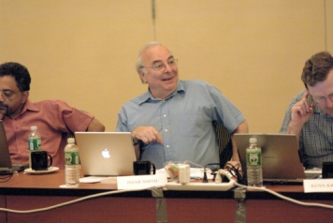
NIH Peer Review System for Grant Applications
First Level of Review
Scientific Review Group
(Study Section)
  Second Level of Review
  NIH Institute/Center Council

Slide 4

Review Process for a Research Grant
National Institutes of Health
Research
Grant Application
School or Other
Research Center
Center for Scientific Review
Assigns to IC & IRG/Study Section
Initiates
Research Idea
Study Section
Submits Application
Reviews for Scientific Merit
Institute
Allocates Funds
Evaluates for Relevance
Advisory Councils and Boards
Conducts
Research
Recommends Action
Institute Director
Takes Final Action

Slide 5

The Gateway for NIH Grant Applications
The Center for Scientific Review
Receives all NIH applications
Refers them to NIH Institutes/Centers and to scientific review groups
Reviews for scientific merit about 70% of all NIH applications

Slide 6
CSR Peer Review – Fiscal Year 2013
84,000 applications received
17,000 reviewers
236 Scientific Review Officers
1,500 review meetings

Slide 7

CSR Mission
To see that NIH grant applications receive fair, independent, expert, and timely reviews – free from inappropriate influences – so NIH can fund the most promising research.

Slide 8
Help Get Your Application to an Appropriate Review Group

Slide 9

Your Application is Assigned to . . .
A Scientific Review Group
An Institute or Center

Slide 10



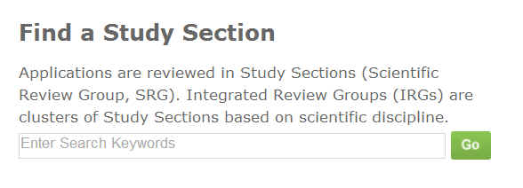
Help Your Application Get to the Right Study Section
http://www.csr.nih.gov/
Notes:
You can search these guidelines on the CSR web site by entering key words into our search engine. These results will be returned by match of your key words to the scope of an Integrated Review Group or Study Section.

Slide 11
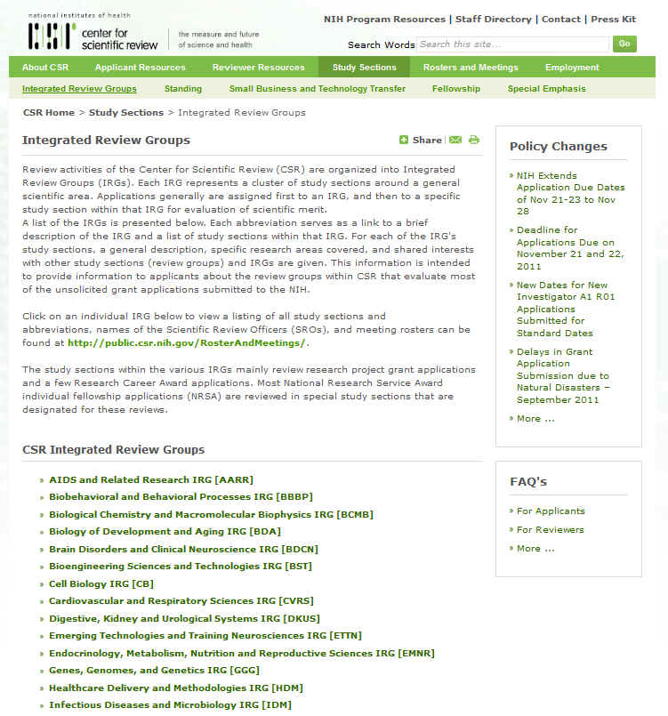
Help Your Application Get to the Right Study Section
Integrated Review Group
Notes:
Study sections are administratively clustered by area of science into Integrated Review Groups or IRG. You can look at the description of the IRG and then find a list of study sections in that IRG.

Slide 12
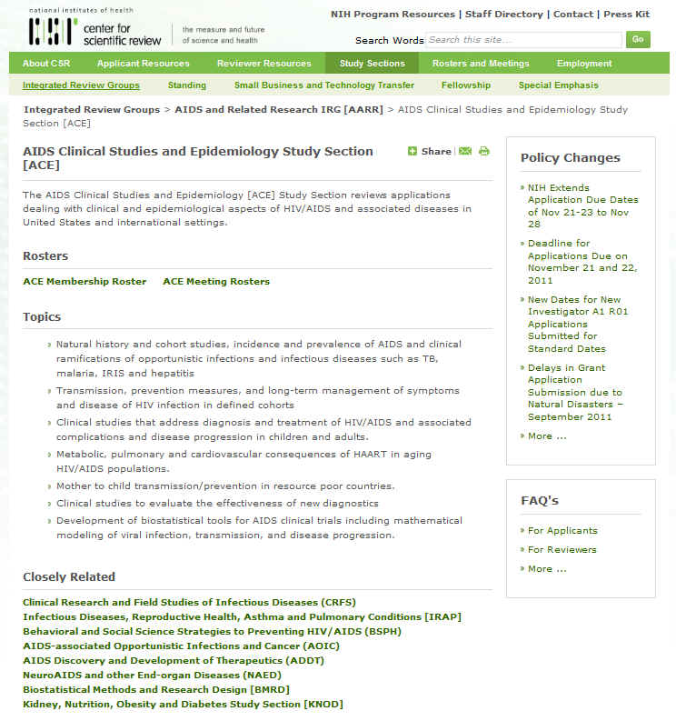
Help Your Application Get to the Right Study Section
Study Section
Notes:
If you click on the link to one of the study sections, you will find a description of the science they review and also links to closely related study section

Slide 13
Cover Letter
The cover letter should be used for a number of important purposes:
Suggest Institute/Center assignment
Suggest review assignment
Identify individuals in potential conflict and explain why
Identify areas of expertise needed to evaluate the application
Discuss any special situations
It is NOT appropriate to use the cover letter to suggest specific reviewers.
Notes:
You communicate assignment preferences to the NIH via cover letter submitted with your application. Cover letters are for communication with NIH staff; they do not go to your reviewers. Cover letters are not required because our staff are very knowledgeable about where your science will fit into one of our institutes and study sections . However, if you wish to suggest an IC or study section assignment, or bring any other issues to the attention of the SRO who will be managing the review, you should include a cover letter. Things you can include in a cover letter…

Slide 14
Sample Cover Letter
Please assign this Phase I SBIR “Drugs for Retinoblastoma Treatment” (RFA-CS-00-000) to the following:
Institutes/Centers
National Cancer Institute
National Eye Institute
Scientific Review Group
Oncology Translational and Clinical IRG
Please do not assign this application to the following:
Scientific Review Group
Biological Chemistry and Macromolecular
Biophysics
This study focuses on a new in vitro model for testing drugs for treatment of retinoblastoma, not the synthesis of new chemotherapeutic agents.
Notes:
The simpler the better. Using this format, with one request per line, we can easily understand your requests. Remember that we are processing hundreds of applications submitted for the major receipt dates and a request buried on the second page of a long cover letter describing your science could easily be missed. Be clear and we’ll do our best to honor your request.

Slide 15
How Your Application Is Reviewed

Slide 16
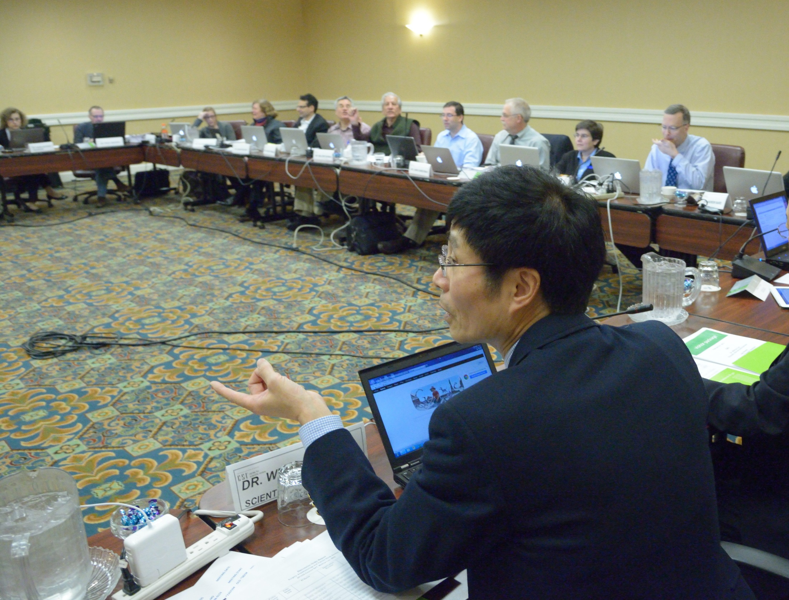
Your Scientific Review Officer Takes Charge
Your SRO is a doctoral-level scientist with expertise relevant to
your field who manages the overall peer review of your application.
Notes:
The overall peer review process of your application is managed by a designated federal official, the scientific review officer or SRO, who has doctoral level expertise relevant to your field.

Slide 17

Your SRO Assigns at Least Three Reviewers to
Your Application
Notes:
In preparation for a study section meeting, at least three scientists with broad experience in the external scientific community are assigned to your application by the SRO. Extra reviewers may be recruited to ensure your application is reviewed appropriately.
Reviewers receive applications and their specific assignments 6 – 8 weeks in advance of the scheduled date of the meeting allowing them plenty of time to prepare. It is typical for each member of a panel to have 8 – 10 total application assignments.
Reviewers assess each application by providing prior to the meeting:
A preliminary Overall Impact score
Criterion Scores for each of the 5 Core Review Criteria
A written critique

Slide 18
What Your SRO Looks for When Recruiting Reviewers
Demonstrated scientific expertise/research support
Doctoral degree or equivalent
Mature judgment
Work effectively in a group context
Breadth of perspective
Impartiality
Diversity
Geographic distribution

Slide 19

The Study Section Meeting
Your SRO Convenes the Study Section Meeting
Notes:
WHAT IS A STUDY SECTION MEETING LIKE?
Each CSR standing Study Section has typically ~12-25 regular members who are primarily from academia, but also from biotech industry and sometimes government research laboratories. Temporary members may be recruited to fulfill specific review needs.
Typically about 60-100 applications are reviewed by each study section

Slide 20
At the Meeting: Application Discussion
    Any member in conflict with an application leaves the room
    Reviewer 1 introduces the application and presents critique
    Reviewers 2 and 3 highlight new issues and areas that significantly impact scores
    All eligible members are invited to join the discussion and then vote on the final overall impact score

Slide 21

Discussions Focus on the Best Applications
    Reviewers typically discuss the top half of the applications
    The panel will discuss any application a reviewer wants to discuss
Notes:
The remaining applications will not be discussed unless explicitly recalled by any member of the panel. Even if your application is not discussed, you will receive the detailed critiques from each of your assigned reviewers.
We've talked broadly about evaluation and alluded to scoring. Let's look at more detail of how this is done.

Slide 22



Career Stage Consideration
New Investigator or Early Stage Investigator Applications
R01 grant applications: Your status is formally considered and NIH is committed to funding a significant number of these applications.
Other grant applications: Your career stage is factored into the Investigator critique.
NIH must have correct info on your career stage
Notes:
A new investigator in NIH context is an applicant who has not yet successfully competed for a substantial NIH research grant.
Early Stage Investigators are New Investigators who are within 10 years of completing their terminal research degree or their medical residency at the time they apply for R01 grants.

Slide 23
Main Review Criteria
Overall Impact
    Assessment of the likelihood for the project to exert a sustained, powerful influence on the research field(s) involved
Core Review Criteria
Notes:
The Overall Impact score is the ultimate score in evaluation for DISCUSSED applications.
To arrive at an overall impact judgment, reviewers evaluate each application first according to a set of five specific core criteria as follows:

Slide 24
Core Review Criteria
Significance
Notes:
Significance: Unlike the Overall impact, the Significance assumes success, i.e. Assuming that all the aims are successful, does the project address an important problem or a critical barrier to progress in the field, or have the ability to improve knowledge, technical capability or clinical practice? Does the project ADVANCE the field?

Slide 25
Core Review Criteria
Significance
Investigator(s)
Notes:
Investigators: Are they qualified? If they are ESI or NI as defined earlier, for an R01 application, do they have appropriate experience and training? For ESIs, fewer publications and/or less preliminary data would be expected. This is in contrast to Established Investigators, where one would look a demonstrated, ongoing record of accomplishments.
In addition, the Investigators’ independence is not a score-driving issue

Slide 26
Core Review Criteria
Significance
Investigator(s)
Innovation
Notes:
Innovation
Does the application challenge and seek to shift current research or clinical practice paradigms by utilizing something novel? Is what is proposed novel to one field of research or novel in a broad sense? Is what’s proposed a refinement, improvement, or new application? Remember innovation can be something brand new or application of old technology applied in a new way or to something new

Slide 27
Core Review Criteria
Significance
Investigator(s)
Innovation
Approach
Notes:
Approach. Is it well-reasoned and appropriate to accomplish the specific aims of the project? Potential problems, alternative strategies, and benchmarks for success presented? If the project is in the early stages of development, will the strategy establish feasibility and will particularly risky aspects be managed?

Slide 28
Core Review Criteria
Significance
Investigator(s)
Innovation
Approach
Environment
Notes:
Environment: For R01 ESIs: is the institutional investment (e.g., start-up funds/mentoring arrangements, etc.) appropriate for the proposed work?
After assessing these five criteria, reviewers develop an overall impact judgment that embodies the summary judgment of that reviewer. Each assigned reviewer is expected to discuss openly how he has arrived at the synthesis even though there is no prescription as to how one should do that.

Slide 29
Additional Criteria Contribute to Overall Impact Scores
Protections for human subjects
Inclusions of women, minorities and children
Appropriate use of vertebrate animals
Management of biohazards
Notes:
These are factored into the Overall impact as appropriate.

Slide 30
9-Point Scoring Scale
Impact | Score | Descriptor
High Impact | 1 | Exceptional
 | 2 | Outstanding
 | 3 | Excellent
Medium Impact | 4 | Very Good
 | 5 | Good
 | 6 | Satisfactory
Low Impact | 7 | Fair
 | 8 | Marginal
 | 9 | Poor
Notes:
Reviewers are asked to provide a numerical score for each of the five criterion areas and for overall impact. The NIH scoring system uses a 1 to 9 integer scale to score overall impact and these five criteria areas.
30

Slide 31
Scoring
Each panel member provides an overall impact score.
Range of Scores
After discussion, assigned reviewers state final Overall Impact Scores, defining the score range.
Panel members may vote outside this range although any intent to do so must be declared.
Notes:
If your application is among the ones discussed, then each member of the study section will provide a private overall impact score for your application assuming they have no conflict of interest.
If a reviewer votes outside the scoring range of the assigned reviewers, it is fine. Consensus is not the objective of a review. A reviewer may vote outside the range based on:
▪ a scientific difference of opinion
▪ different weighting of the review criteria
▪ a perceived mismatch between the words/score provided by the assigned reviewers
The reviewer’s dissent should be transparent from his/her participating in the discussion or raising a hand and providing a brief reason why at the time of final scoring.
The final overall impact priority scores for each application are averaged to 1 decimal place and multiplied by 10, ranging from10, most meritorious, to 90 least meritorious.
The budget is considered after scoring. The review group will either recommend the budget is funded as requested or suggest changes.

Slide 32
Other Considerations that Do Not Affect Overall Impact Scores
Resource Sharing Plans:
  Data
  Model Organisms
  Genome Wide Association Studies
Foreign Organizations
Select Agents
Budget
Notes:
Data sharing plans are only needed for applications seeking $500,000 or more.
Select agents are a specific set of agents and toxins kept by CDC in a publically available list.

Slide 33

Your Application Could Be Reviewed Electronically
Electronic reviews are used to facilitate reviewer participation
Electronic Review Platforms
Telephone Assisted Meetings
Internet Assisted Meetings
Video Assisted Meetings
Notes:
33
While most panels bring reviewers to meet face-to-face, some are convened wholly or partially via electronic platforms. These added modes are utilized to provide maximum flexibility in bringing together the appropriate expertise for review of research proposals.

Slide 34

After Your Review
Your SRO
Prepares summary statements
Provides information to NIH Institutes and Centers
Notes:
responds to NIH institute and center requests for information about study section recommendations.

Slide 35

Your Summary Statement
Scores for each review criterion
Critiques from assigned reviewers
Administrative notes if any
If your application is discussed, you also will receive:
An overall impact/priority score and percentile
ranking
A summary of review discussion
Budget recommendations
Notes:
The summary (resume) of the discussion itself is written by the SRO
Summary statements are released within 30 days of the meeting except for R01 applications submitted by New Investigators or Early Stage Investigators, which are released within 10 business days of the meeting for first submissions only.
Once received, the Investigator/applicant may then discuss the contents of the summary statement with the Program Officer, but the SRO who prepared it is not at liberty to do so.

Slide 36
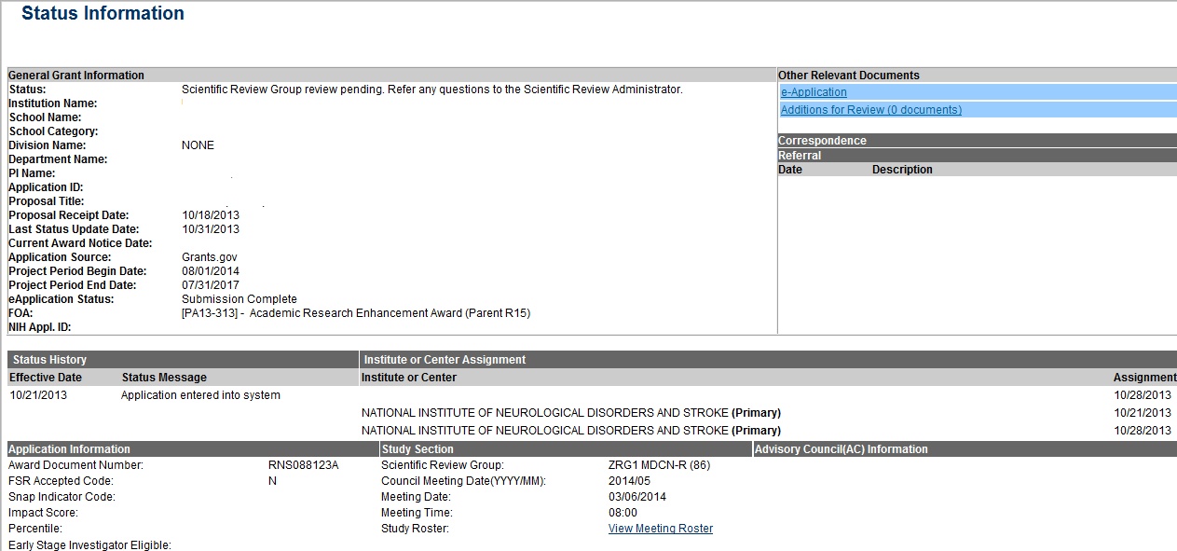
Check the Status of Your Application in NIH Commons
Status
Meeting Date
Notes:
The arrow at the top of the page points to the status of the sample application section, which states " Scientific Review Group review pending. Refer any questions to the Scientific Review Administrator." An arrow at the bottom of the image points to the date of the review meeting that will assess the given application.

Slide 37
When Preparing an Application
Read instructions
Never assume that reviewers will know what you mean
Refer to pertinent literature
State rationale of proposed investigation
Include well-designed tables and figures
Present an organized, lucid write-up
Obtain pre-review from faculty at your institution
NIH Grant Writing Tips
http://grants.nih.gov/grants/grant_tips.htm
Notes:
Also, try to convey the value of the research in plain language and remember your audience
These and other grant writing tips of general nature can be found online at the NIH web site at the following URL.

Slide 38
What Reviewers Look for in Applications
Impact
Exciting ideas
Clarity
Realistic aims and timelines -- Don’t be overly ambitious
Brevity with things that everybody knows
Noted limitations of the study
A clean, well-written application
Notes:
Please proof read for typographical errors as this also makes a very favorable impression.
Balance with respect to detail: meaning brevity for things everybody knows across disciplines but give more/enough details so reviewers will know what you mean

Slide 39
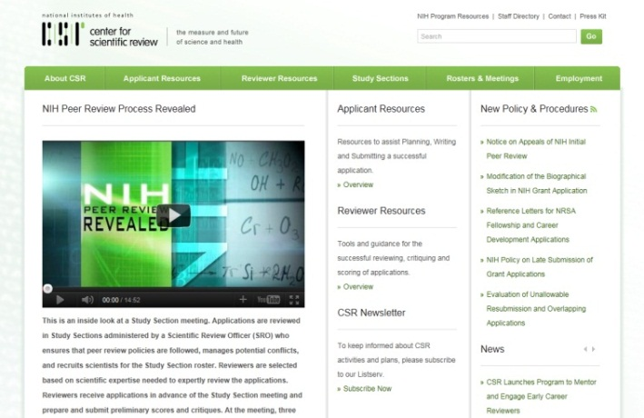
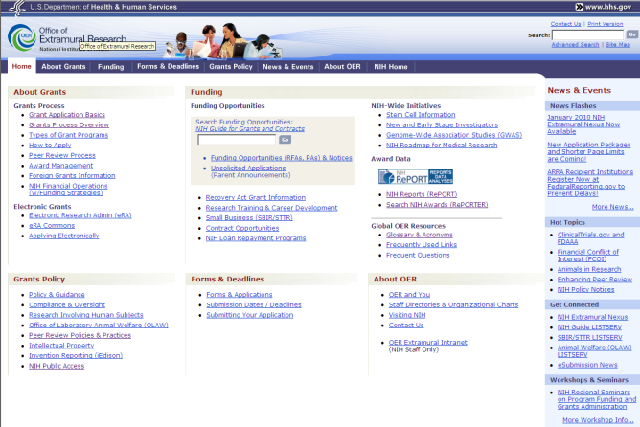
Key NIH Review and Grants Web Sites
NIH Center for Scientific Review
http://www.csr.nih.gov
NIH Office of Extramural Research
http://grants.nih.gov/
Notes:
A lot of critical information and answers to your questions can be found online . . . .

Slide 40
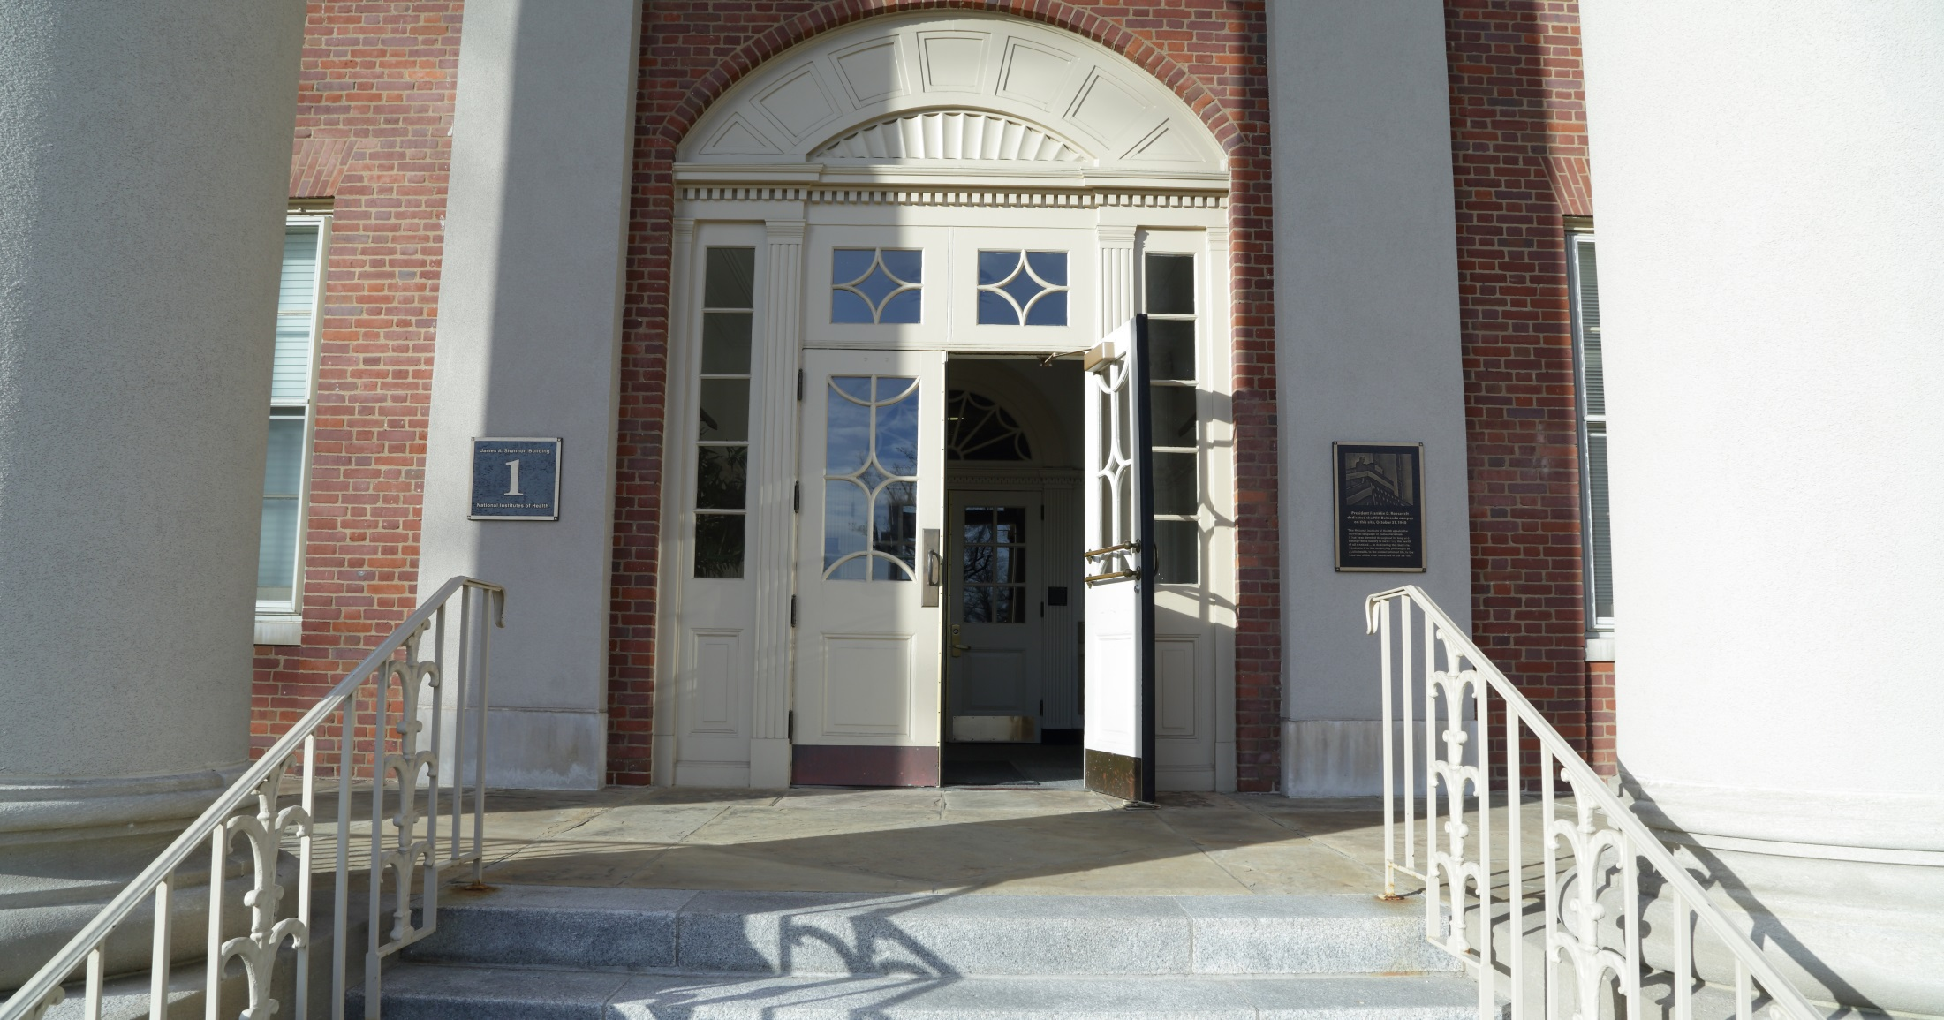
We Want Your Applications!
Notes:
We want you to send us your promising research applications!

