Slide 1


Research Centres 2016 Call – Webinar
January 2016
Abstract Deadline: 04/03/16, 1pm
Pre-Proposal Deadline: 28/04/16, 1pm

Slide 2
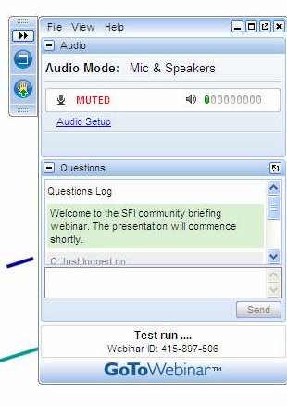
Webinar Instructions
This webinar consists of a short PowerPoint presentation with voiceover (1-way!)
We’ll walk you through the presentation and answer questions at the end
Submit questions by text on the GoToMeeting control panel – be concise
We will post link to recording of webinar on www.sfi.ie shortly
Notes:
Note that we will run identical webinar next Friday at 2pm

Slide 3
Presentation Overview
Background
Main Changes to 2016 Call
Definitions
Expectations
Centre Structure
Industry Partners & Funding
Eligibility Criteria
Application Steps & Review Criteria
Post-Award Reporting & Monitoring
Other SFI Industry Collaborative Programmes
Notes:
I would first like to present the SFI team involved in managing the Research Centres programme.
Pre-award who will be running the call for proposals……….
Post-award, who manage oversight and evaluation of centres once funded…..

Slide 4
Centres Programme Background
Agenda 2020: develop a set of Research Centres which:
  are recognised internationally;
  attract international research talent and capital; and
  attract, anchor and spin out related companies in Ireland
First launched in 2012 as an evolution of the previous CSET and SRC programmes
Programme aims to consolidate research activities across HEIs
Create a critical mass of internationally leading researchers in strategic areas
Notes:
I would first like to present the SFI team involved in managing the Research Centres programme.
Pre-award who will be running the call for proposals……….
Post-award, who manage oversight and evaluation of centres once funded…..

Slide 5

Centres Programme Background
2012 Call: 7 Research Centres funded
2013 Call: 5 Research Centres funded
€350m from SFI over 6 years
€190m co-investment by over 250 industry partners
Funded consortia are typically made up of many (or all) of the leading researchers in the country in a particular discipline
http://www.sfi.ie/investments-achievements/sfi-research-centres/
Notes:
I would first like to present the SFI team involved in managing the Research Centres programme.
Pre-award who will be running the call for proposals……….
Post-award, who manage oversight and evaluation of centres once funded…..

Slide 6
Main Changes to 2016 Call
Non thematic call - open to all areas of SFI’s legal remit (previously thematic)*
No limit on number of Co-PI’s (2013: limit of 9)
No restriction on max platform activities budget (2013: max 30%)
Applicants encouraged to attract contributions from ‘other non-exchequer sources’ (see later)
Changes to submission documentation
  Changes in section lengths
  FI’s & collaborators not required to submit CV’s
  Requesting a plan for how RC will transition to sustainability
  Requesting additional details of EPE plans
* Proposals must be clearly distinct from current Research Centres. Those in similar areas should be submitted to the Spokes Programme
Notes:
I would first like to present the SFI team involved in managing the Research Centres programme.
Pre-award who will be running the call for proposals……….
Post-award, who manage oversight and evaluation of centres once funded…..

Slide 7
Centres Programme Objectives
Achieve, maintain and enhance research excellence and leadership
Deliver significant economic and societal impact
Increase the level of industrial and commercial investment in R&D activities with existing Ireland-based companies, and help to attract FDI
Spin out new, high-technology start-up companies
Transfer technology, through licences to companies based in Ireland
Transfer knowledge, expertise & know-how to companies based in Ireland
Undertake joint research projects with industry
Inspire, educate & train future/current STEM students/researchers
Attract additional non-Exchequer funding
Engage the general public and equip them to understand and debate STEM
Notes:
I would first like to present the SFI team involved in managing the Research Centres programme.
Pre-award who will be running the call for proposals……….
Post-award, who manage oversight and evaluation of centres once funded…..

Slide 8
Important Definitions
Lead Applicant | Defined as Scientific & Technical Lead Nominated as Research Centre Director Will hold primary responsibility for the award
Co-Applicant | Well-defined, critical & continuing role Expected to lead one or more targeted project(s) Note: Receives equal evaluation to Lead Applicant
Funded Investigator | Member of academic staff undertaking a management role in a research project in the RC Should have budgetary responsibility for a project FI designation should be a reflection of the level of input of an individual to the research programme
Notes:
I would first like to present the SFI team involved in managing the Research Centres programme.
Pre-award who will be running the call for proposals……….
Post-award, who manage oversight and evaluation of centres once funded…..

Slide 9
Important Definitions
Official Collaborator | Academic staff member (based in Ireland or abroad) or member of relevant non-academic institution (e.g. Govt. Dept.) Provide a focussed contribution to specific task(s) May not act as primary supervisor of team members
Industry Partner | Company making a financial contribution to the Centre as well as an intellectual contribution to the research programme
Industry Collaborator | Lead contact(s) from an industry partner making cash or in-kind contributions Not eligible to receive funding
Centre Budget | 3 components: SFI cash contribution; Industry cash contribution; and Industry in-kind contribution Direct costs only (i.e. overheads not factored in)
Notes:
I would first like to present the SFI team involved in managing the Research Centres programme.
Pre-award who will be running the call for proposals……….
Post-award, who manage oversight and evaluation of centres once funded…..

Slide 10
Centre Expectations
Have an ‘edge’ over competing research activities world-wide – unique features, potential to be world leading in its domain
Clear demonstration of ‘added value’ of being funded as a Centre rather than as individual awards
Lead Applicant with record of internationally recognised research achievement and demonstrated ability to lead major academic-industry partnership initiatives
Carry out a unifying research programme in areas covered by the remit of the proposed programme
Achieve the strategic goals shared by the host and partnering institutions
Stimulate public understanding, interest & engagement in STEM
See Section 4 of the Call Document for further details
Notes:
I would first like to present the SFI team involved in managing the Research Centres programme.
Pre-award who will be running the call for proposals……….
Post-award, who manage oversight and evaluation of centres once funded…..

Slide 11
Research Centre Size
SFI expects to fund a range of Centre sizes
We want to fund Centres that have ambition and growth potential
Small and excellent is better than large and mediocre
It may be more appropriate to be a spoke in a larger centre
Notes:
I would first like to present the SFI team involved in managing the Research Centres programme.
Pre-award who will be running the call for proposals……….
Post-award, who manage oversight and evaluation of centres once funded…..

Slide 12
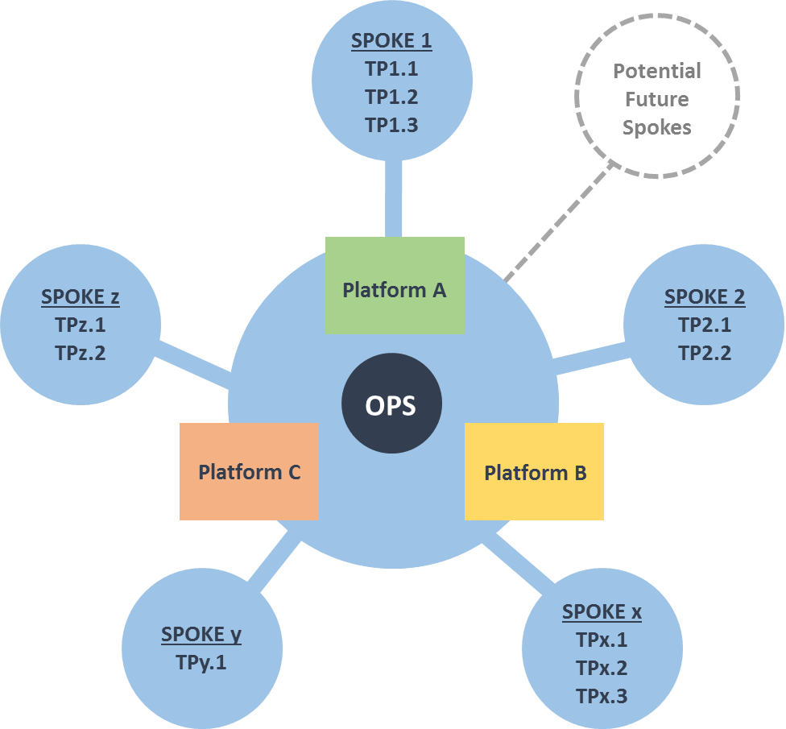
Research Centre Structure
Based on Hub & Spoke Model
Notes:
I would first like to present the SFI team involved in managing the Research Centres programme.
Pre-award who will be running the call for proposals……….
Post-award, who manage oversight and evaluation of centres once funded…..

Slide 13
Research Centre Structure
Based on Hub & Spoke Model
The Hub consists of:
  Operations: management, administration, business development, marketing & communications, EPE & IT technical support staff
  Platform research: core/platform research activities or technologies which are deemed necessary/ valuable to the RC mission and are common across a number of TPs or which underpin the development of future TPs
Notes:
I would first like to present the SFI team involved in managing the Research Centres programme.
Pre-award who will be running the call for proposals……….
Post-award, who manage oversight and evaluation of centres once funded…..

Slide 14
Research Centre Structure
Based on Hub & Spoke Model
Spokes consist of thematically related targeted projects (TPs)
A spoke can have one or multiple TPs
Each TP must have at least one Industry Partner
Spokes can be added to Research Centres using the Spokes Programme
Notes:
I would first like to present the SFI team involved in managing the Research Centres programme.
Pre-award who will be running the call for proposals……….
Post-award, who manage oversight and evaluation of centres once funded…..

Slide 15
Industry Partners
Each targeted project must involve at least 1 industry partner
Expectation of mix of large and small companies
Industry partners should provide both a financial contribution and an intellectual input into the research programme
Non-Irish based companies can participate but direct benefit to Ireland must be clearly demonstrated
Commercial semi-state bodies are eligible as industry partners
Government agencies, charities or other not-for-profit entities not eligible as industry partners (but could be collaborators)
Notes:
I would first like to present the SFI team involved in managing the Research Centres programme.
Pre-award who will be running the call for proposals……….
Post-award, who manage oversight and evaluation of centres once funded…..

Slide 16
Funding Available
SFI contribution max 70%
  €1-5M per annum (direct costs) over duration of six years
  Can exceed upper limit subject to matched funding
Min 10% industry cash*
Min 30% total industry contribution (cash + in-kind)*
Must maintain min. 30% cost-share over the lifetime of the RC
*Note: Funding from ‘other non-exchequer sources’ does not count towards the minimum industry cost share requirements
Notes:
I would first like to present the SFI team involved in managing the Research Centres programme.
Pre-award who will be running the call for proposals……….
Post-award, who manage oversight and evaluation of centres once funded…..

Slide 17
Funding from ‘other non-exchequer sources’
Applicants encouraged to consider the inclusion of contributions from other national and international funding agencies, philanthropic organisations or other sources (e.g. charity, not for profit organisations)
Potential benefits:
  Increased level of funding for the Centre overall
  Assist in developing the sustainability of the proposed Centre
  Demonstration of the importance of the proposed Centre to key stakeholders
Note: Will not count towards industry cost share, nor will it leverage additional SFI funds
Notes:
I would first like to present the SFI team involved in managing the Research Centres programme.
Pre-award who will be running the call for proposals……….
Post-award, who manage oversight and evaluation of centres once funded…..

Slide 18
High Level Eligibility Criteria
Applicant Group
  Consists of Lead Applicant (Director) and Co-Applicants
  Min of 10 senior author publications each
  Hold at least 1 independent research grant each
  Secured min. €10m combined research funding 2010-2016
Lead Applicant can only be named on 1 application only
Co-Applicant can be named on up to 2 applications
Notes:
I would first like to present the SFI team involved in managing the Research Centres programme.
Pre-award who will be running the call for proposals……….
Post-award, who manage oversight and evaluation of centres once funded…..

Slide 19
Research Centre Network
Targeted projects that connect with an existing RC may be supported either through the Spokes Programme or the Centres Programme
  Note: RC proposals which are not clearly distinct from existing RCs are likely to be returned without review
Applications for funding a particular spoke may not be under review for the Spokes and Centres Programmes at the same time
Currently funded Research Centres
  Lead PI / Directors not eligible as Lead or Co-Applicants
  Co-PI’s may apply as Co-Applicants or FIs
Notes:
I would first like to present the SFI team involved in managing the Research Centres programme.
Pre-award who will be running the call for proposals……….
Post-award, who manage oversight and evaluation of centres once funded…..

Slide 20
Key Weaknesses of Unsuccessful Proposals
Not all members of applicant group were internationally competitive
Case for Centre funding not clearly made (e.g. lack of synergy)
Ability of Centre to compete internationally questioned
  Scope too broad (small & excellent better than big & mediocre!)
  Lacking in critical mass of excellent researchers
  Unique aspects of proposed Centre unclear
Failure to demonstrate strong potential for delivery of economic impact to Ireland
  Poorly developed business plan
  Collaborative nature of partnership with industry unclear
Notes:
I would first like to present the SFI team involved in managing the Research Centres programme.
Pre-award who will be running the call for proposals……….
Post-award, who manage oversight and evaluation of centres once funded…..

Slide 21
Application Steps & Review Process
Abstract submission (not subject to review)
Pre-proposal submission
  Review by combined scientific and impact panel
  Scientific quality and impact equally weighted
Full proposal submission (invitation only)
  Postal review (scientific evaluation only)
  Applicant response
  Proposals demonstrating scientific excellence will progress
  Impact panel evaluation, includes a presentation from applicants
  List of fundable proposals ranked in order of priority for funding
Notes:
I would first like to present the SFI team involved in managing the Research Centres programme.
Pre-award who will be running the call for proposals……….
Post-award, who manage oversight and evaluation of centres once funded…..

Slide 22
Application Steps & Review Process
Abstract submission (not subject to review)
  Title of proposal
  Name of Host Institution
  Name of Lead Applicant (Director)
  Scientific Abstract (200 words max)
  Template on SFI Research Centres 2016 webpage
  Email to Centres@sfi.ie
  Deadline: 4th March 2016, 1pm
Notes:
I would first like to present the SFI team involved in managing the Research Centres programme.
Pre-award who will be running the call for proposals……….
Post-award, who manage oversight and evaluation of centres once funded…..

Slide 23
Application Steps & Review Process
Pre-proposal submission (SESAME)
  Proposal Summary (Title, funding request, duration, research area(s), SFI remit alignment)
  Lead & Co-Applicant details* (Location, % time commitment, CV, publications, supervisory experience)
  List of Collaborators (Funded Investigators, Academic Collaborators and Industry Collaborators).
    Note: CVs not required
  Main Body of Proposal (Keywords, scientific abstract, lay abstract)
*Note: no restriction on the max. number of Co-Applicants BUT, each Co-Applicant will receive equal evaluation to the Lead-Applicant
Notes:
I would first like to present the SFI team involved in managing the Research Centres programme.
Pre-award who will be running the call for proposals……….
Post-award, who manage oversight and evaluation of centres once funded…..

Slide 24
Application Steps & Review Process
Pre-proposal submission (SESAME)
  Profile of Applicant Group (max 3 pages)
  Funding History (min €10m in defined period)
  Research Programme (max 5 pages)
    Overall vision of the proposed RC
    Specific research questions to be addressed by the RC
    Current state-of-the-art & how the RC will advance it
    Why is a RC required? What is the competitive advantage of the team to deliver in this area?
Notes:
I would first like to present the SFI team involved in managing the Research Centres programme.
Pre-award who will be running the call for proposals……….
Post-award, who manage oversight and evaluation of centres once funded…..

Slide 25
Application Steps & Review Process
Pre-proposal submission (SESAME)
  References
  Impact Statement (max 5 pages)
  Membership Structure (max 1 page, only if applicable)
  Budget Justification (max 1 page)
Notes:
I would first like to present the SFI team involved in managing the Research Centres programme.
Pre-award who will be running the call for proposals……….
Post-award, who manage oversight and evaluation of centres once funded…..

Slide 26
Application Steps & Review Process
Pre-proposal submission (SESAME)
  Summary Budget (MS Excel budget template)
  Letters of Support (see templates)
    Each proposed industry partner
    Each organisation committing ‘other non-exchequer funding’
  Prior research funding of the applicant group
    Description of any scientific overlap with RC proposal
  Deadline: 28th of April 2016, 1pm
  Remember – your institution may have internal approval steps
Notes:
I would first like to present the SFI team involved in managing the Research Centres programme.
Pre-award who will be running the call for proposals……….
Post-award, who manage oversight and evaluation of centres once funded…..

Slide 27
Application Steps & Review Process
Full proposal submission (SESAME)
  By invitation only, following review of pre-proposals
  Requirement for both scientific excellence and strong potential for impact in order to progress to full proposal stage
  Anticipate inviting to submit full proposal in late July 2016
  Deadline: 2nd of November 2016, 1pm
  Full proposals demonstrating a high level of scientific excellence will be invited to present to an impact panel in Feb/March 2017
Notes:
I would first like to present the SFI team involved in managing the Research Centres programme.
Pre-award who will be running the call for proposals……….
Post-award, who manage oversight and evaluation of centres once funded…..

Slide 28
Evaluation Criteria
Team
  Quality, significance, and relevance of the recent research record of the lead and co-applicants and;
  The strength and cohesiveness of the applicant group, including likely synergy in delivering research and potential for international leadership
Research
  Quality, significance, and relevance of the proposed research, including value for money and;
  The potential to advance knowledge and understanding within its own field or across different fields
Notes:
I would first like to present the SFI team involved in managing the Research Centres programme.
Pre-award who will be running the call for proposals……….
Post-award, who manage oversight and evaluation of centres once funded…..

Slide 29
Evaluation Criteria
Potential for impact
  Quality, significance, and relevance of the proposed research’s potential contribution to demonstrably support and underpin enterprise competitiveness and societal development in Ireland
Execution & Delivery (full proposal only)
  Quality of plans for execution and delivery of the research programme and Centre goals, including the appropriateness of the proposed milestones and deliverables
Notes:
I would first like to present the SFI team involved in managing the Research Centres programme.
Pre-award who will be running the call for proposals……….
Post-award, who manage oversight and evaluation of centres once funded…..

Slide 30
Intellectual Property Management
Responsibility of the Research Body to ensure in accordance with national IP policy and compliant with State Aid law
Intellectual Property Rights should be assigned to Industry Partners in a manner which reflects their contributions
Contracts & IP agreements should be executed within 90 days of the award start date
TTO’s are empowered to pursue the most advantageous commercial route for the Research Bodies
See http://www.sfi.ie/funding/grant-policies/intellectual-property-management-guidelines.html for more details
Notes:
I would first like to present the SFI team involved in managing the Research Centres programme.
Pre-award who will be running the call for proposals……….
Post-award, who manage oversight and evaluation of centres once funded…..

Slide 31
Post Award Reporting
SFI uses a number of evaluation instruments for Centres
Monthly -
  Industry contracts & HR update
Every six months -
  KPI report (SESAME) and a governance report
Every year -
  Research outputs / census and annual report
Every two years -
  Site visit with external panel
Regular workshops with Centre Directors & Centre Managers
Notes:
I would first like to present the SFI team involved in managing the Research Centres programme.
Pre-award who will be running the call for proposals……….
Post-award, who manage oversight and evaluation of centres once funded…..

Slide 32
Key Performance Indicators
At the full proposal stage, applicants will be asked to provide targets for 15 KPIs under four headings:
  Academic outputs
  Human capital outputs
  Funding diversification
  Commercialisation
KPIs are aligned with the objectives of the Research Centres Programme, and overall SFI objectives (Agenda 2020)
Notes:
I would first like to present the SFI team involved in managing the Research Centres programme.
Pre-award who will be running the call for proposals……….
Post-award, who manage oversight and evaluation of centres once funded…..

Slide 33
Key Performance Indicators
Academic
  # Journal publications
  # Conference publications
Human Capital
  # MSc/MEng graduates
  # PhD graduates
  % Trainee departures with industry as a first destination
Notes:
I would first like to present the SFI team involved in managing the Research Centres programme.
Pre-award who will be running the call for proposals……….
Post-award, who manage oversight and evaluation of centres once funded…..

Slide 34
Key Performance Indicators
Funding Diversification
  # Participations in major EU initiative
  # Co-ordinations of major EU initiatives
  # ERC awards
  Funding from non-exchequer sources
  Cash in bank (3x: cash, % cash, % in-kind + cash)
Commercialisation
  # Spin-out companies formed
  # EI commercialisation awards
  # Licence agreements
Notes:
I would first like to present the SFI team involved in managing the Research Centres programme.
Pre-award who will be running the call for proposals……….
Post-award, who manage oversight and evaluation of centres once funded…..

Slide 35
Key Performance Indicators
Targets must be ambitious, but realistic and achievable
Targets should reflect strategic & commercial positioning of the Centre
Assessment of KPI targets will form part of the evaluation of the proposal
Additional information on setting KPIs will be supplied to those invited to submit a full proposal
Notes:
I would first like to present the SFI team involved in managing the Research Centres programme.
Pre-award who will be running the call for proposals……….
Post-award, who manage oversight and evaluation of centres once funded…..

Slide 36
Management & Governance Structures
All Research Centres will be required to establish
Executive Committee
Governance Committee
Scientific Advisory Committee
Industry Advisory Committee
See http://www.sfi.ie/funding/grant-policies/grant-policies-sfi-research-centres.html for more guidance on metrics, reporting, intellectual property, management & governance of Research Centres
Notes:
I would first like to present the SFI team involved in managing the Research Centres programme.
Pre-award who will be running the call for proposals……….
Post-award, who manage oversight and evaluation of centres once funded…..

Slide 37
Key Timelines
Deadline for submission of abstracts | 4th March 2016, 13:00
Deadline for submission of pre-proposals | 28th April 2016, 13:00
Invite to full proposals | July 2016
Deadline for submission of full proposals | 2nd November 2016, 13:00
Impact Panel meeting | February/March 2017
Funding Decision | April 2017
Notes:
I would first like to present the SFI team involved in managing the Research Centres programme.
Pre-award who will be running the call for proposals……….
Post-award, who manage oversight and evaluation of centres once funded…..

Slide 38
Other SFI Industry Collaborative Programmes
SFI Spokes Programme 2015
For addition of new projects to Existing Centres
Allows existing Centres to develop in line with new priorities and opportunities
No maximum or minimum budget – projects of scale expected
Rolling Call: 50% cash cost share, assessed based on own merit
Fixed Call: 30% cash cost share, competitive review
  Deadline: 10th of March 2016, 1pm
  Advanced Manufacturing: lower cost share, additional incentives
Notes:
I would first like to present the SFI team involved in managing the Research Centres programme.
Pre-award who will be running the call for proposals……….
Post-award, who manage oversight and evaluation of centres once funded…..

Slide 39
Other SFI Industry Collaborative Programmes
SFI Industry Fellowship Programme
Funds movement of researchers between Academia & Industry
  Salary, travel & subsistence (if Academia to Industry)
  Travel & subsistence (if Industry to Academia)
Up to €120k per fellowship
Up to one year full time or two years part time
Open to Irish and international companies
Open to all levels from Postdoctoral Researcher up to Professor
Deadlines in June and December
Notes:
I would first like to present the SFI team involved in managing the Research Centres programme.
Pre-award who will be running the call for proposals……….
Post-award, who manage oversight and evaluation of centres once funded…..

Slide 40
Other SFI Industry Collaborative Programmes
SFI Strategic Partnerships Programme
Foster and develop strategic partnerships
Initiatives of scale with strong potential for delivering economic impact to Ireland
Cash co-funding requirement of 50%
Flexible programme for projects not otherwise served
Rolling call – open now
2-stage review
  Expression of interest
  Full proposal (by invitation only)
Notes:
I would first like to present the SFI team involved in managing the Research Centres programme.
Pre-award who will be running the call for proposals……….
Post-award, who manage oversight and evaluation of centres once funded…..

Slide 41
If you have a question…..
Q&A session now
Consult the Centres Programme Call Document & FAQ’s
Contact your Research Office
Subsequently, email Centres@sfi.ie
Notes:
I would first like to present the SFI team involved in managing the Research Centres programme.
Pre-award who will be running the call for proposals……….
Post-award, who manage oversight and evaluation of centres once funded…..

Slide 42
Q&A Session
Q&A session now
We may put voice on ‘mute’ for a few minutes while we gather questions – please be patient
Submit your text-based questions via the GoToMeeting control panel
We will deal with as many of these as we can, verbally
We will post a recording of the webinar on the RC 2016 webpage
Notes:
I would first like to present the SFI team involved in managing the Research Centres programme.
Pre-award who will be running the call for proposals……….
Post-award, who manage oversight and evaluation of centres once funded…..

